Slide 1


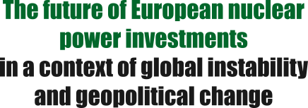

13 October 2022 - Brussels

Slide 2
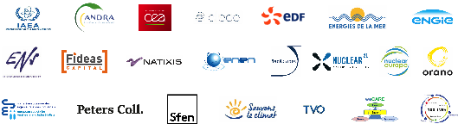
13 October 2022 - Brussels

Slide 3
Opening
An unprecedented geo-economic and geo-political context which calls into question the energy strategy of the European Union and its Member States,
and their relations with other countries in the world
13 October 2022 - Brussels

Slide 4
PART 1
The dynamics of investment in Europe and the world
since the post-war period
And today, given the unprecedented scale of changes, climate disruption and economic and geopolitical crises
13 October 2022 - Brussels

Slide 5
PART 2
The energy choices of European nations are under pressure from the radical change in relations with Russia
Diversifying gas supplies or/and energy mixes
13 October 2022 - Brussels

Slide 6
PART 3
Cooperation in the nuclear sector and between Member States to expand activities in Europe,
Ensure our energy security and remain competitive in the international arena
13 October 2022 - Brussels

Slide 7
Provisional Conclusions
Recommendations for a coherent
energy transition
In Europe
13 October 2022 - Brussels

Slide 8
PART 3
Cooperation in the nuclear sector and between Member States to expand activities in Europe,
Ensure our energy security and remain competitive in the international arena
13 October 2022 - Brussels

Slide 9
Provisional Conclusions
Recommendations for a coherent
energy transition
In Europe
13 October 2022 - Brussels

