Slide 1


The future of European nuclear power investments
in a context of global instability and geopolitical change
Let’s Energise Sustainability
| We Are Nuclear-21:
An independent expert cabinet providing bankable decision support driving policy, strategies and business development towards optimised nuclear-based solutions

Slide 2








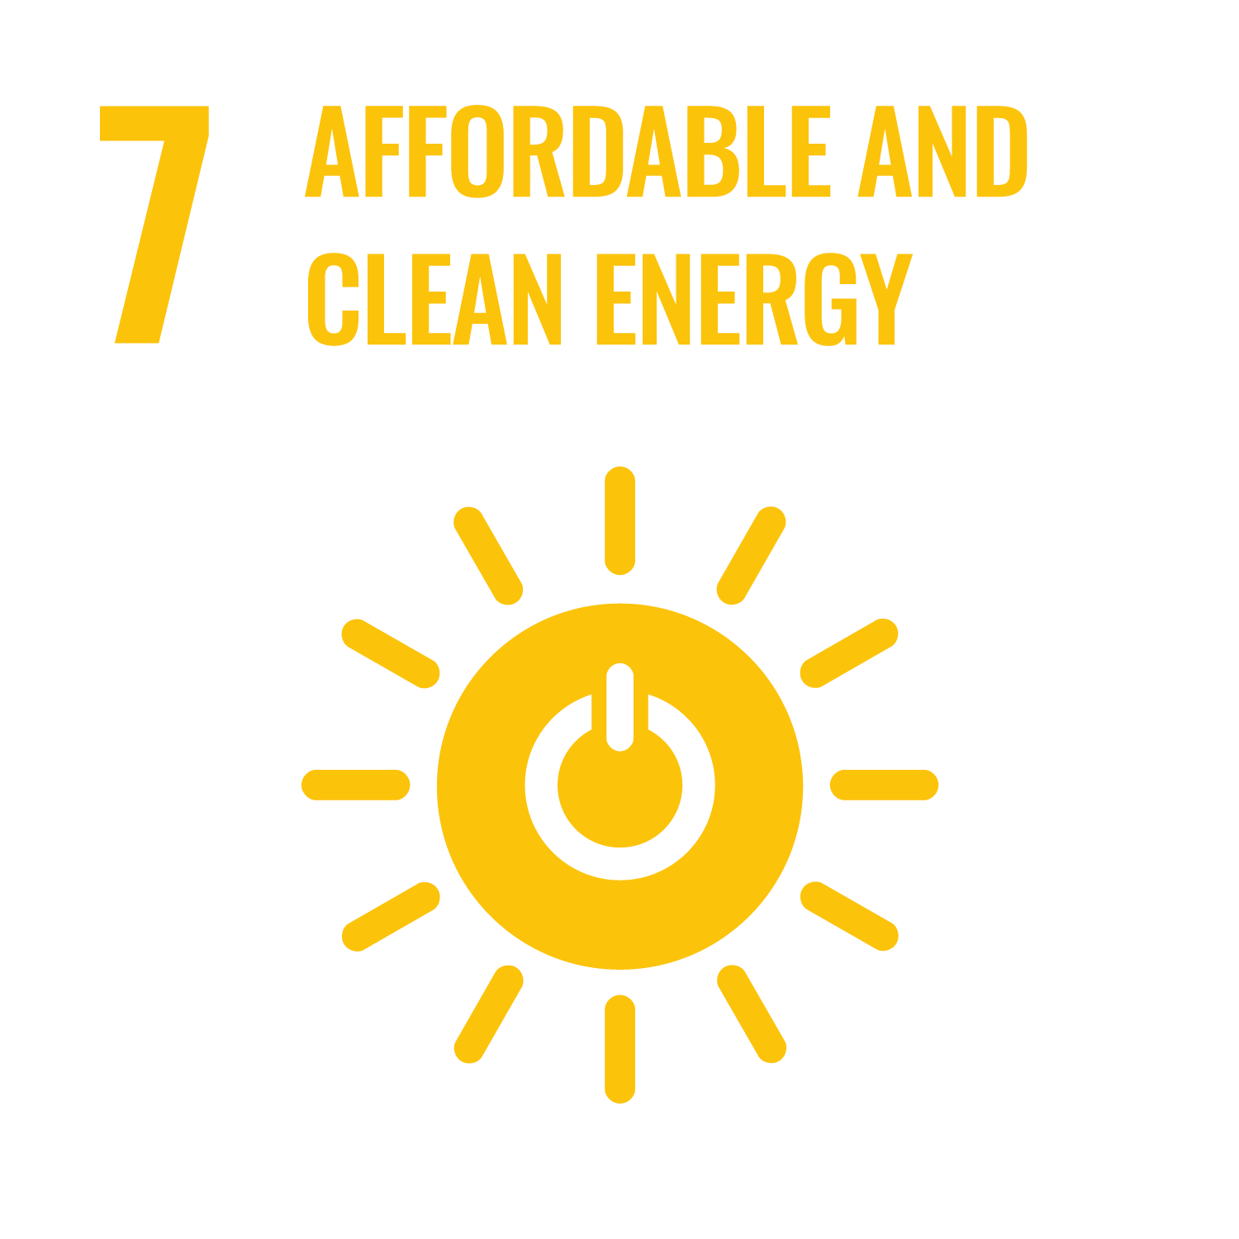









| We exist thanks to nuclear … let’s use it wisely to provide a future to us all now and forever
Let’s Energise
Sustainability

Slide 3
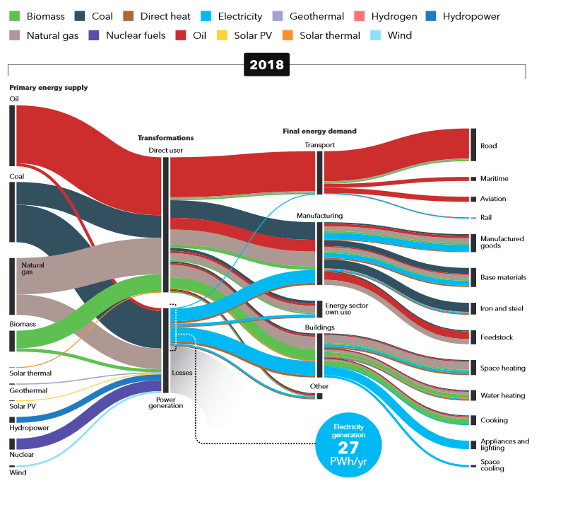
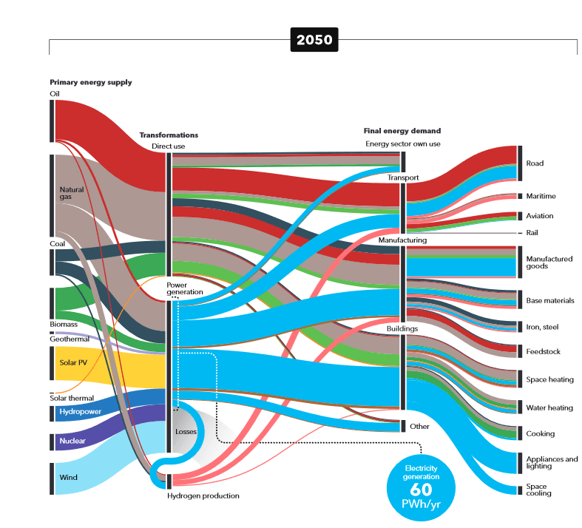
| Major trends in energy systems worldwide
An energy systems view is essential ... ideally with a policy spanning multiple decades
Ref. DNV GL Energy Transition Outlook 2020

Slide 4
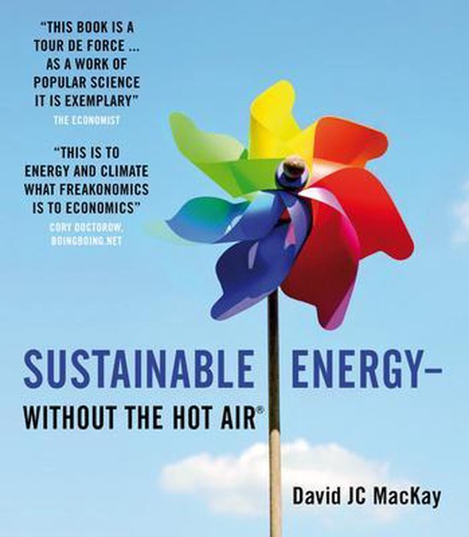
| And time is pressing

Slide 5
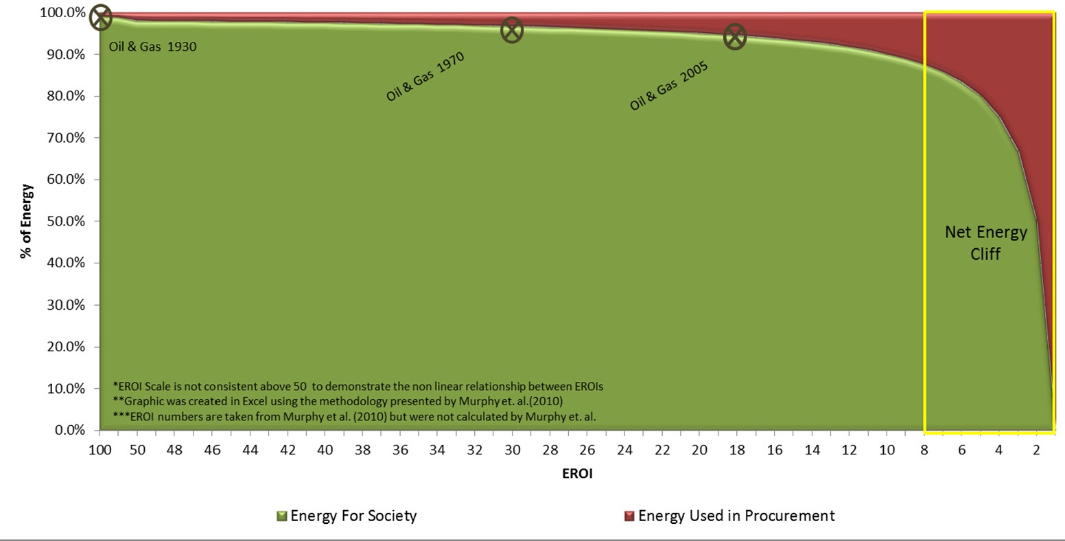

| The increasing « Energy Cliff Dilemma »
Nuclear
Coal
Wind
Shale Oil
CSP
PV
Corn Ethanoll
Complementarity of low-carbon energy options is a necessity and will demand synergies between regional, typically higher EROEI, with local, typically lower EROEI, energy solutions

Slide 6

| On the future of Nuclear Energy
Our challenge
  Positioning nuclear energy in a constantly changing energy market
    After a liberalisation and deregulation wave since the end of last century challenging the nuclear energy competitiveness,
    And after an euphoric transition period in favour of renewables
    A global decarbonisation wave is developing in consideration of the contribution of energy to climate change and related States commitments
    Tomorrow, post-COVID a “back-to-basics” wave, i.e. resilience of the energy system and a more holistic systems approach into energy systems may find its place?
  Tomorrow’s sustainable energy market will demand a nuclear energy even better suited to
  Serve various energy market segments as reliable energy conversion source
  Remaining competitive
  Guaranteeing safety, security and safeguards performance
  Guarantee that all reasonably recoverable materials are optimally managed and waste responsibly disposed of
  Reducing the waste amount and long-term stewardship requirements
  and, gradually, using less natural resources

Slide 7









| We do not lack options to answer the demands … now and tomorrow … but let’s focus to deliver
Transmutation of Actinides
ADS
Intra-Nuclear Function
MA
Pu + MA
Reprocessing and multiple Recycling
Pu
Reprocessing and mono-Recycling
MOX
UOX
Direct Disposal
Energy Market
Electricity
District Heating Water Desalination
Industrial Proces Heat
Hydrogen Production

Slide 8
| We have to shape our future …
Unfortunately, we’re back into an energy crisis … or better … a systems’ crisis
  In OECD countries, replacement of major infrastructures required allowing to reshape our (energy) systems
Nuclear energy is and can be part of the sustainable solution
  But we also need to focus and deliver
  And value the strategic value of nuclear energy for Europe
If we want to embrace a sustainable European (nuclear) energy future … we’ll need to cluster even more
  From R&D up to industrialisation
    “If we don’t redress the R&D-focus during the coming 20 years … we might not have a demand anymore for nuclear R&D”
  More than ever, energy-intensive industry’s existance is being challenged … begging for low-carbon, safe, predictable, reliable and competitive energy and increasingly electricity … let’s deliver on this !

