Slide 1
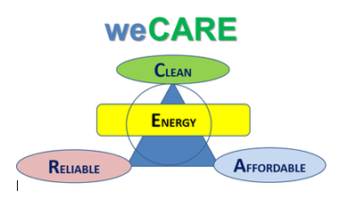
Marc Deffrennes
ENTRETIENS EUROPEENS
13 Octobre 2022

Slide 2
…which has been stable on a global level over the last 50 years.
2°C requires a drop in the
carbon intensity of primary energy (tCO2/GJ)
70
60
INDCs
50
World historic
40
World 6DS
World 2DS
30
OECD historic
Non-OECD historic
20
Sweden historic
10
0
1960
1970
1980
1990
2000
2010
2020
2030
2040
2050
Source: Energy Technology Perspectives, 2016

Slide 4
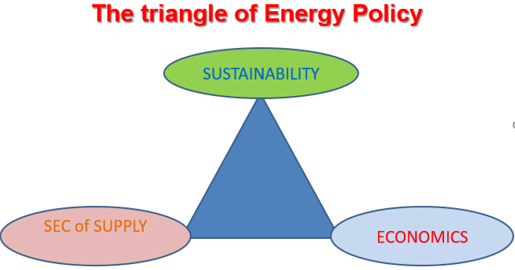

Slide 5
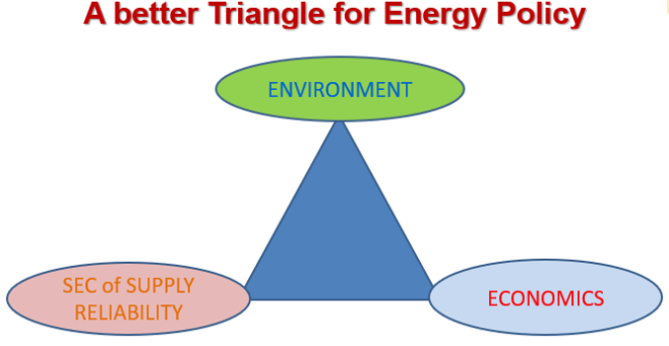

Slide 6
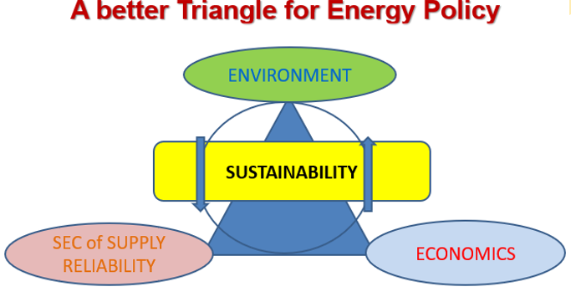

Slide 7
