Slide 1
TVO today
Les Entretiens Européens, Brussels 13.10.2022

Slide 2
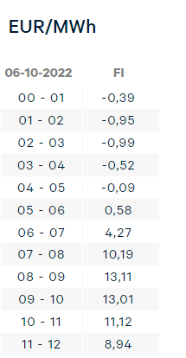
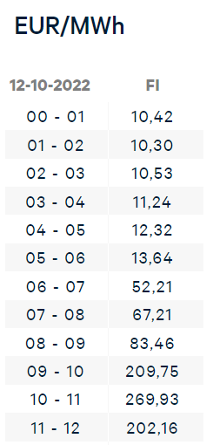
Nord Pool market prices, Finnish price area

Slide 3
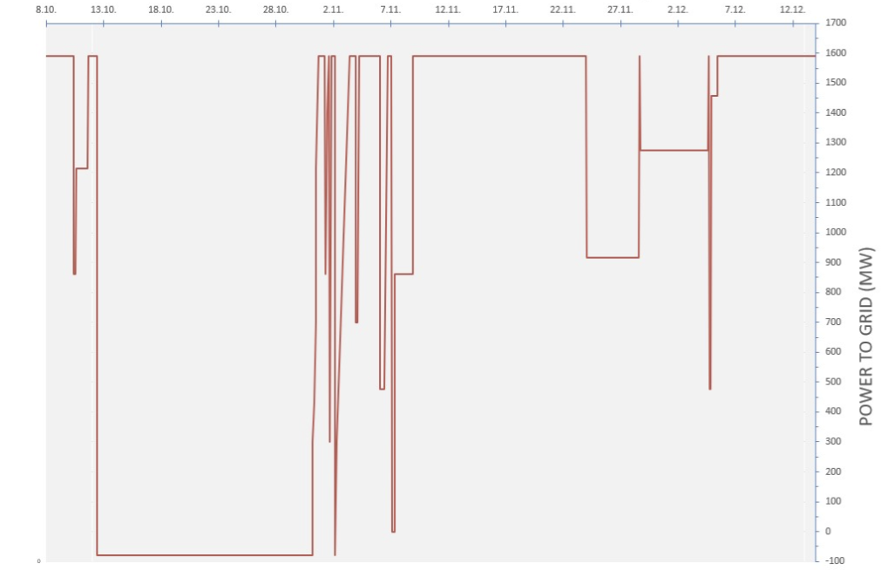
OL3 power output during test production phase
12.10.2022

Slide 4

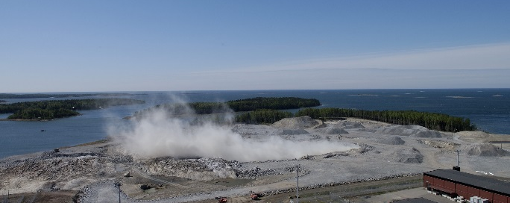
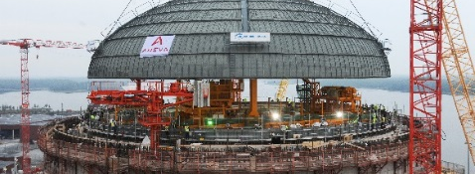
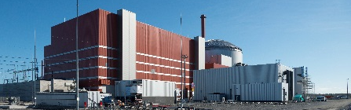
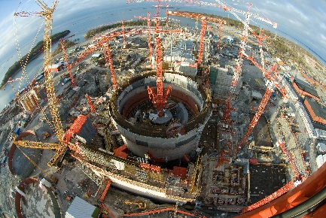
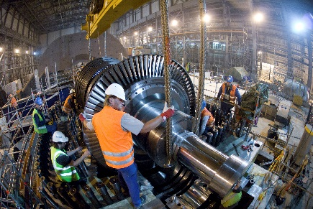
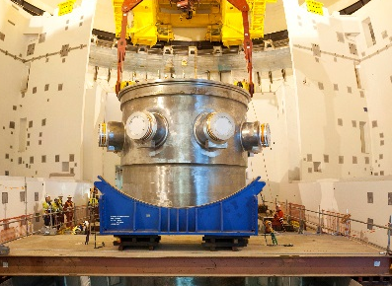
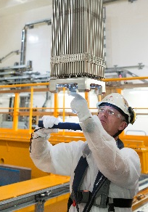
Olkiluoto 3 milestones
2022
Start of electricity production
2021
2019
Fuel loading
First Criticality
2018
Finnish Government granted opera- ting licence
2017
Fuel is in Olkiluoto
Hot functional tests competed
Operators got licenses
Outer dome of the reactor building was completed
Cooling water tunnels in use
2016
Cold functional tests competed
Reactor building dome installed
Manpowerpeak 4500
Pressurizer was brought into the reactor building
2015
Comple-tion of Full Scope Simula-tor testing
2014
Safety automation systems arrived in Olkiluoto
Reactor building containment liner rises to level +12,5 m
2013
Contain-ment pressure tests completed
2012
Reactor pressure vessel closure head installed
TVO started the infra works and handed the construction site to Areva-Siemens
Installation of the bottom part of containment liner
2011
Turbine island was connected to the national grid
2010
Steam generators in place
July, First concrete poured
2009
The decision-in-principle by in the Finnish parliament
Contract signing between TVO and the plant supplier
2008
2007
2006
2005
2004
2003
2002

Slide 5
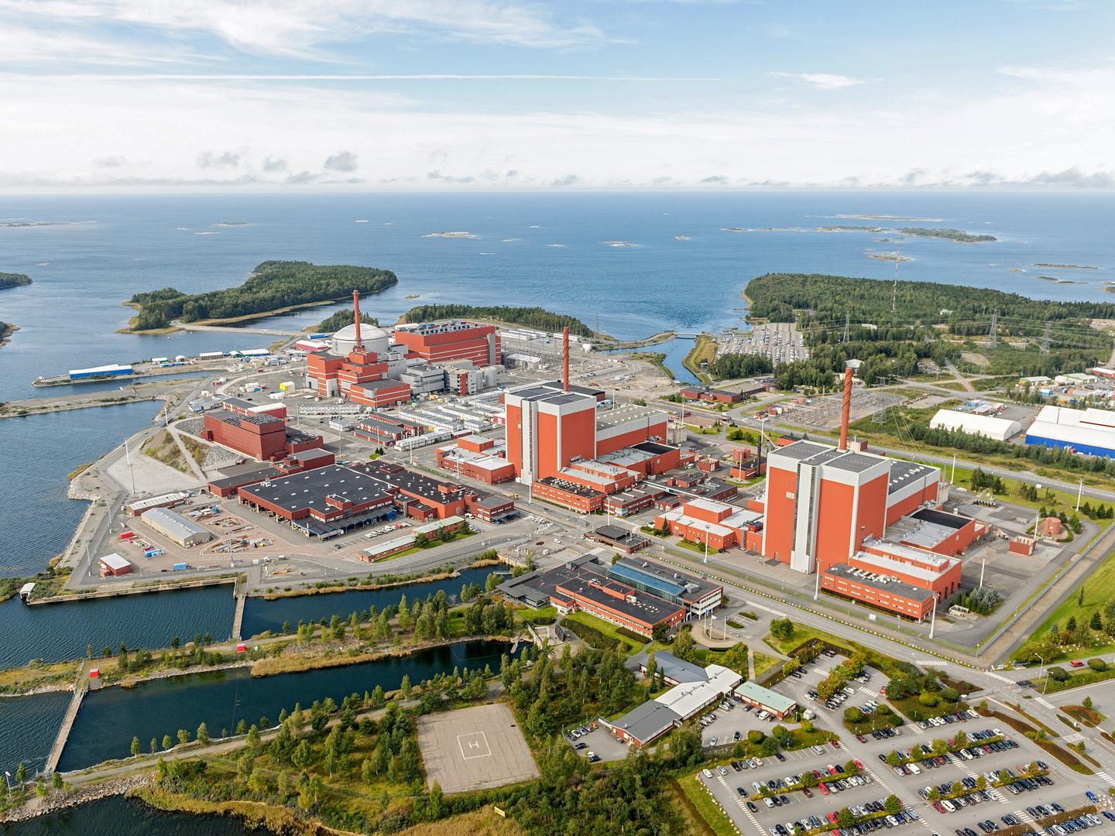

Slide 6
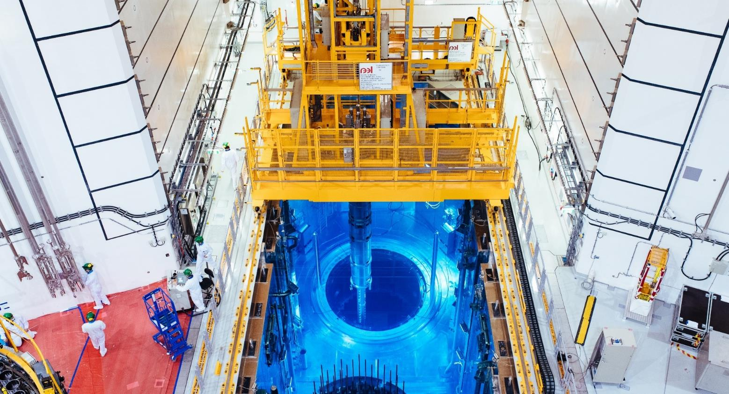
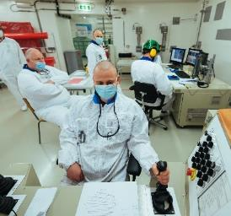
Olkiluoto 3
Fuel Loading 27th March – 1st April 2021

Slide 7
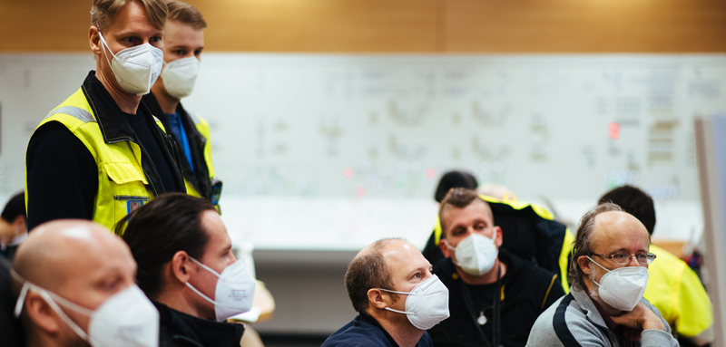
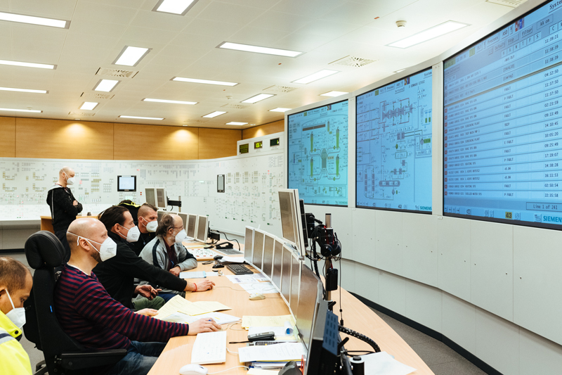
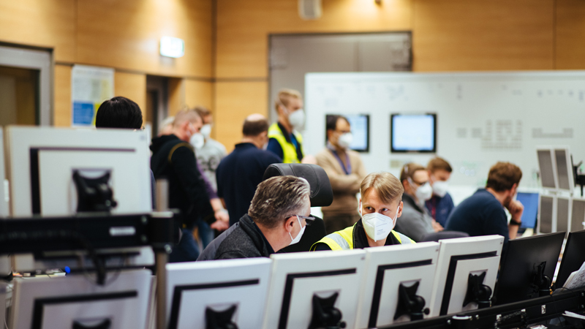
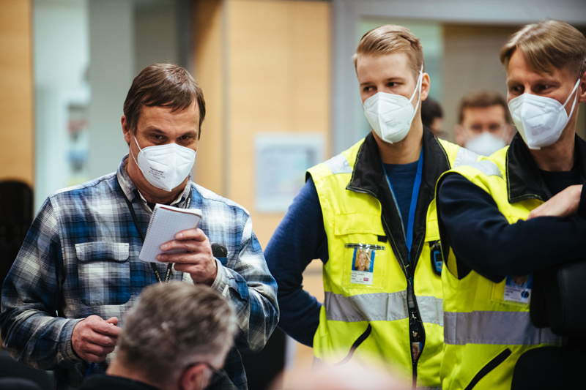
The connection to grid 12 March 2022, at 12.01 p.m.

Slide 8
SUPPORT FOR NUCLEAR POWER IN FINLAND
What is your general attitude to nuclear power as an energy source in Finland?
Source: Kantar TNS 2022,
Energiateollisuus ry

Slide 9
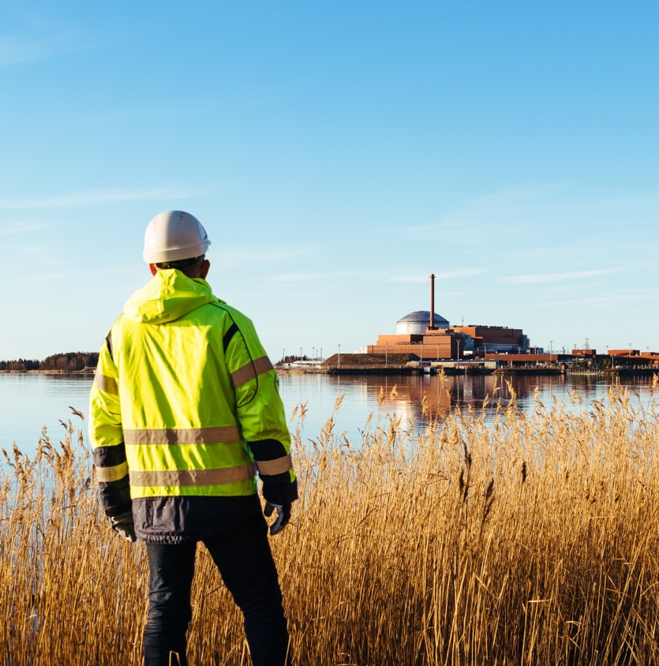
NUCLEAR INDUSTRY’S DILEMMA
Acceptability is the highest ever, need for new nuclear is clear.
Industry is suffering from country specific regulation, FOAK problem
SMR technology is not yet available.
Solutions are expected from us in the 2020s, but we can offer them in the 2030s

Slide 10
Harmonization and use of standard industrial component is the key for future
IAEA, NHSI -project
European SMR Partnership
Nordic KELPO
New, harmonized
KELPO-processes
New Nuclear Energy Act + YVL-guidelines in Finland

Slide 11
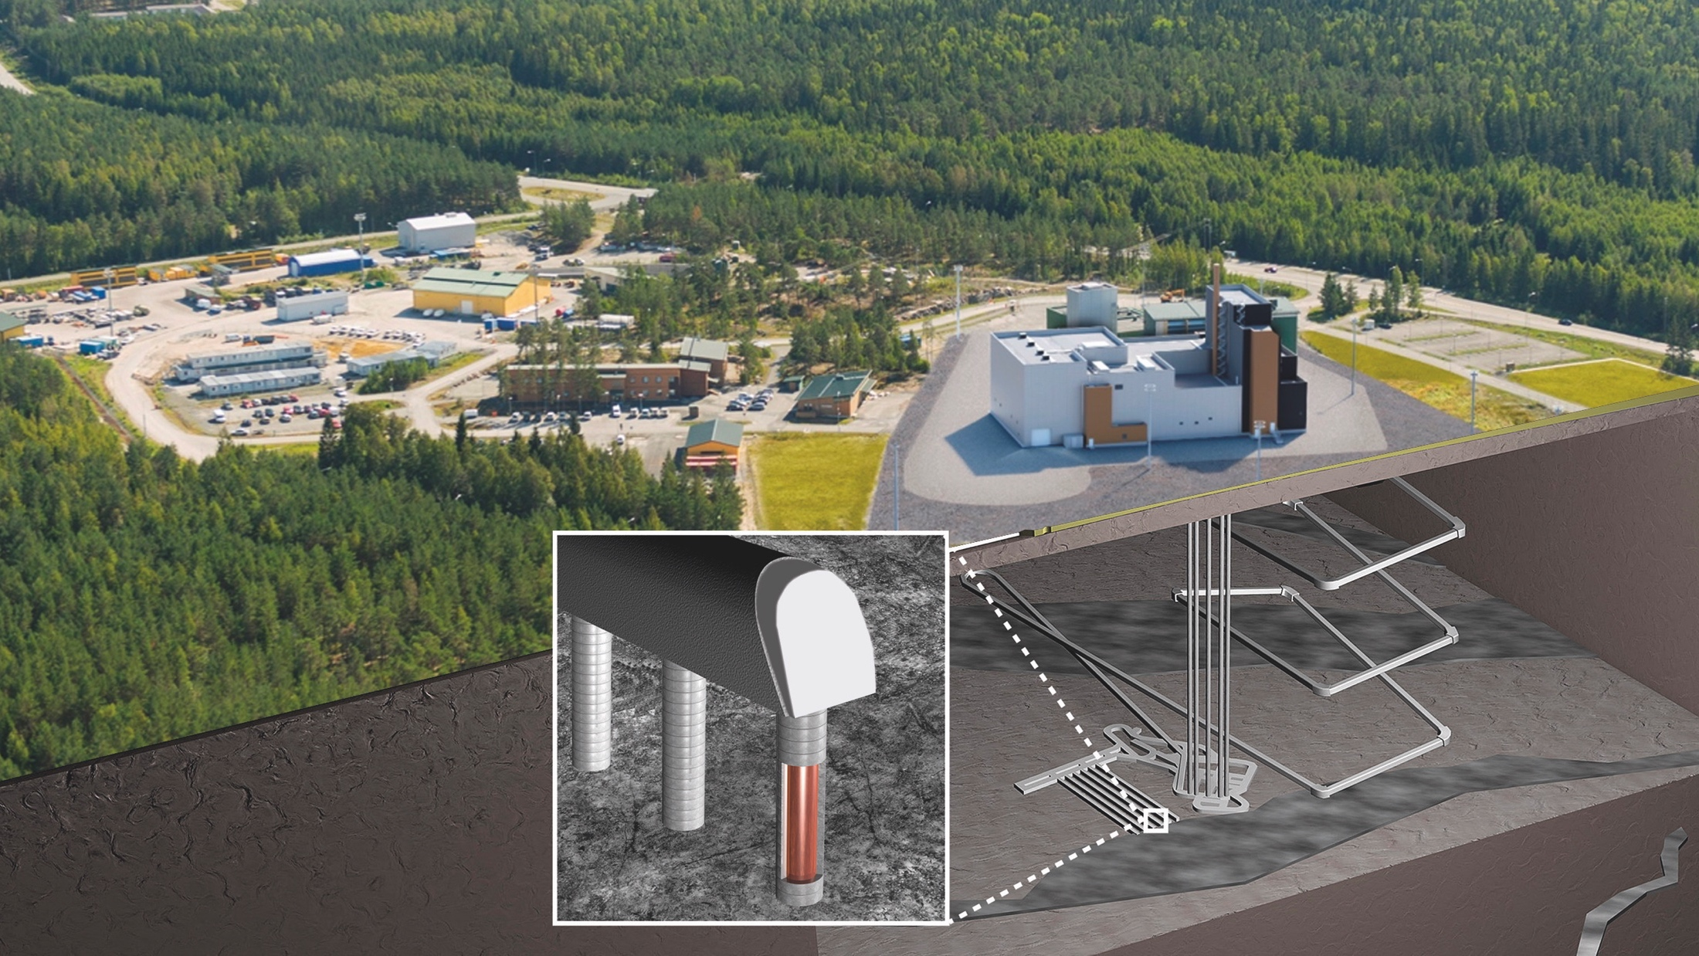

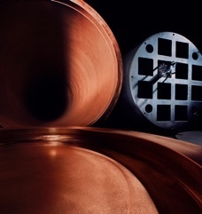
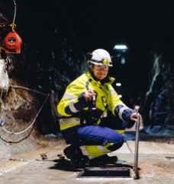
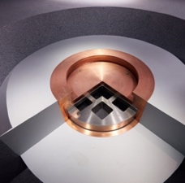
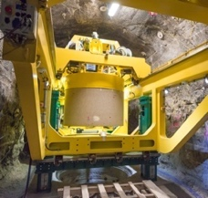

We have a solution
for the final disposal
of spent fuel
We have a significant
role in climate change
as a part of the
sustainable nuclear energy
#wehaveasolution
Site investigations
Development of the engineered barriers
Equipment development

