Slide 1
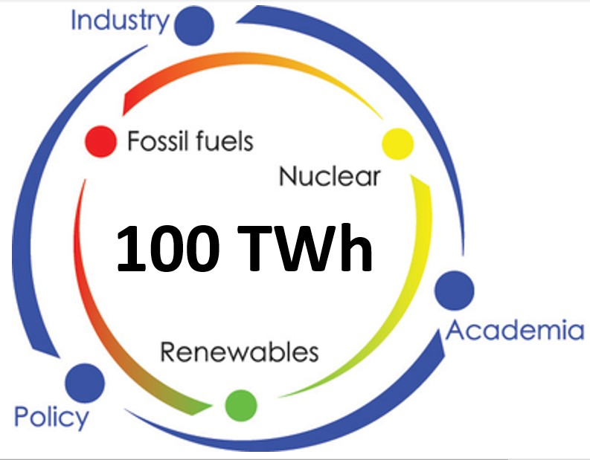
Nuclear future in Belgium
Henri Marenne – Chairman “100TWh” Non-profit organisation

Slide 2
Belgian Energy History
allergic to the word "nuclear".
« Scheurtjes centrales »
Tell me what I have to prove

Slide 3
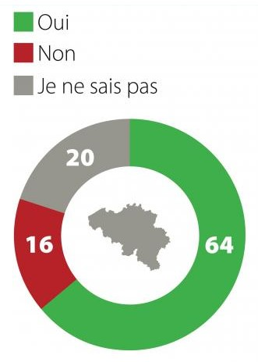
Opinion of the Belgian population September 2022

Slide 4
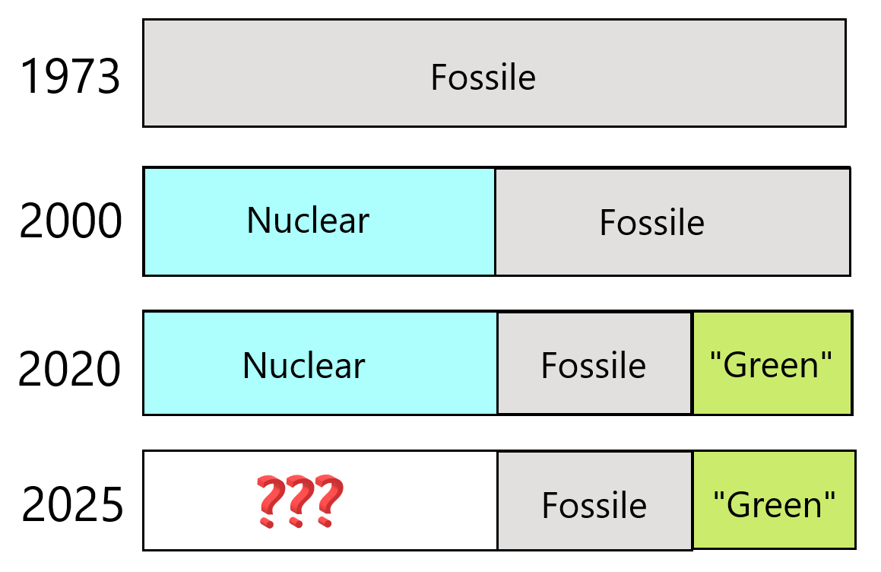
Belgian Energy History
1973 – Oil crisis
2000 – EU plan 20/20/20
2020 – Belgium is a low emission country
2025 - ?

Slide 5
Belgian energy figures in 2022
Power plants | Power | Production
Nuclear | 6 GW | 47 TWh
Wind mills | 3 GW Offshore + 2,3 GW Onshore | 11,5 TWh
Solar | 6 GW | 6,5 TWh
Other renewables | 1,5 GW | 6 TWh
Fossils & other | 5 GW | 23 TWh
Sources : Elia Adequacy report 2021 & SPF Economy september 2022

Slide 6
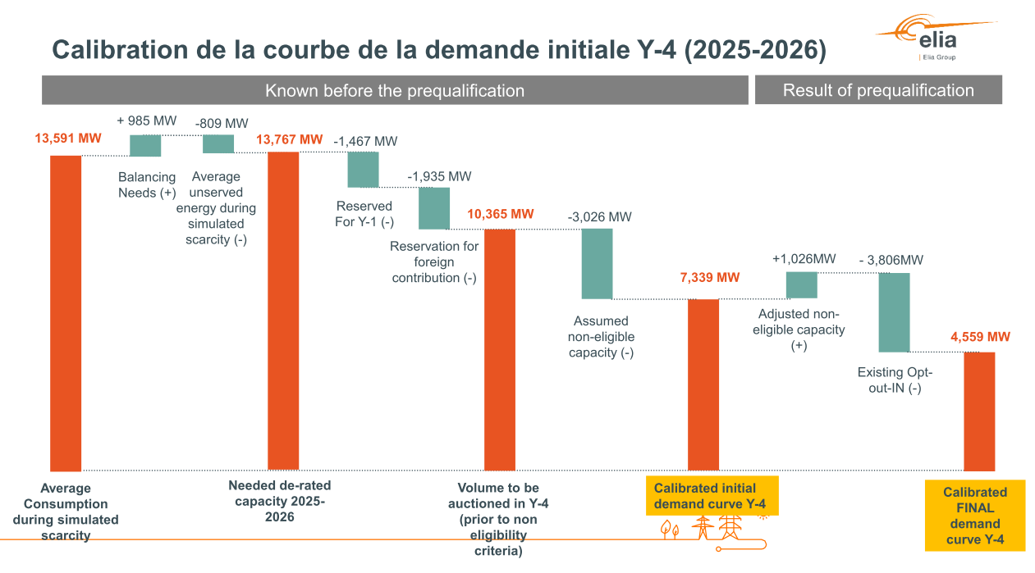
How to phase-out nuclear in 2025
Estimations of ELIA

Slide 7
Estimations Elia >< 100TWh
Comparison ELIA >< 100TWh
> Needs
> Demand mgt
> Imports
> CRM future
> CRM 2021
Description for citizen | Corresponding terminology ELIA | Estimation ELIA (MW) | Estimation 100TWh (MW)
Estimation of the winter peak (MW) | Average Consumption during simulated scarcity | 13591 | 15000
Estimation "corrected" of the winter peak | Needed de-rated capacity 2025-2026 | -176 | 0
Sub-total 1 |  | 13767 | 15000
Realistic « demand side management" | Reserved for Y-1 | -1467 | 0
Sub-total 2: estimated electricity peak |  | 12300 | 15000
Import contracts | Reserved for foreign contributions | -1935 | 0
Capacity already subsidised | Assumed non eligible capacity | -3026 | -3026
Capacity subsidised that could receive CRM | Adjusted non eligible capacity | 1026 | ?/0
Capacity that could receive CRM but didn’t tender | Existing opt-out-IN | -3806 | -1806
Capacity « selected » for the CRM | Calibrated FINAL demand curve | -4559 | -3679
Capacity tendering for CRM but not selected | Non pris en compte par ELIA | 0 | 110
Total without nuclear capacity |  | 0 | 6599
Capacity of our 7 nuclear reactors (reduction factor of 80%) | Non pris en compte par ELIA | 0 | -4752
New nuclear capacity needed |  | 0 | 1847

