Slide 1
The European Nuclear Education Network
Skills and apprenticeships. The urgent need to develop national training and equip it with a European dimension
Dr. Gabriel Pavel
Executive Director

Slide 2
Skills and apprenticeships.
Who needs them?

Slide 3
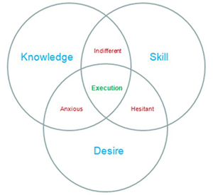
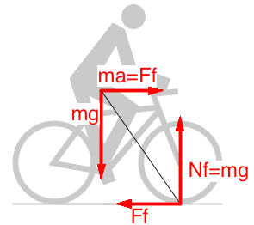
Know-why vs. know-how
Education
Why?
Knowledge
Research
Curiosity
Academia
Training
Knowledge mngmt
How?
Skills
Experience
Need
Industry
Knowledge communities
http://stage-gate.com/newsletter/nl_feb_2012.htm
Borrowed from Leon Cizelj – former ENEN President

Slide 4
Why we need nuclear Education and Training?
ENEN’s answer to support creation and maintaining of competences in order to ensure the best qualified workforce to:
Set the best safety standards;
Have highly professional nuclear inspectors nuclear regulators;
Manage nuclear engineering, chemistry, radiation protection, waste management, geological disposal, decommissioning;
Develop nuclear Medicine (isotopes use in cancer treatments) and other non-power applications (cf. space, agriculture)
Energy - security of supply

Slide 5
The urgent need to develop national training and equip it with a European dimension

Slide 6
Do we need more nuclearists?
YES:
Existing installations: need more people;
New prospects (France, Poland, Romania, etc.): need more people;
New technologies (SMR – “There are about 50 SMR designs and concepts globally.” (Small modular reactors (SMR) | IAEA): need more people;
Non-power applications (medicine, agriculture, etc.): need more people.

Slide 7
When it comes to education and training: Who reacts to this need?
National authorities?-> not possible since education needs to receive an equal “interest’ for all disciplines;
Companies?-> hardly;
E.C.-> yes at the level of creating competences;
Youngsters/new generations?-> yes: after years of decline, number of students started increasing in various countries: Slovenia, Romania, Belgium – SCK Academy, Austria….
Who supports them?

Slide 8
ENEN
The main objective is the sustainability and further development of expertise in the nuclear fields by higher Education & Training:
Promote and further develop the collaboration in nuclear education and training of students, researchers and professionals
Ensure the quality of nuclear education and training
Increase the attractiveness for engagement in the nuclear fields for students, researchers and professionals
Promote life-long learning and career development at post-graduate or equivalent level

Slide 9
2022 figures
Today, ENEN has more than 80 Members and Partners from 25 countries:
Universities, Research Centers, Companies, TSOs, International Institutions;
18 EU Member States (ENEN Members – European Nuclear Education Network);
12 international institutions (MoU).

Slide 10
ENEN Role
Activities executed by ENEN
Organization of Education and Training activities for:
Academia - all related topics
Non power applications
Industry
Regulatory
etc.
Coordination of EU-projects, financed by EU
Dissemination and Communication activities
Support for mobility of students
The R&D is carried out by ENEN members.

Slide 11
With support from EC DG RTD and EC DG INTPA
Safeguards and security
Mobilities
T&T IntPa
Medicine
Research infrastructures
OFFERR
Notes:
DO you have a logo for OFFERR
And a better title for Tamasz proj?
SECURE technically → soon to start

Slide 12
With support from EC DG RTD and EC DG INTPA
Radio-chemistry
Leadership for safety
SMR
Reactor safety
Notes:
DO you have a logo for OFFERR
And a better title for Tamasz proj?
SECURE technically → soon to start

Slide 13
Ideas
The complexity of ensuring the proper training and an adequate & necessary number highly skilled and trained persons to cope with the need calls for high level of support, coordination and partnership between all nuclear stakeholders [industry, academia, regulators, …], especially those involved in all levels of decision-making.

Slide 14
Ideas
Attract, develop and enable future generation of nuclear professionals with outstanding knowledge, skills and competences:
In order to evolve and innovate one must first understand how AND why the existing the installations work,
Excellence is obtained in increasingly multidisciplinary, multicultural and highly competitive environments.
K,S,C, everybody needs them. Only the methodology of obtaining and their use is different.
EU support framework is needed for a positive message!

Slide 15
Thank you for Your attention
gabriel.pavel@enen.eu

