Slide 1
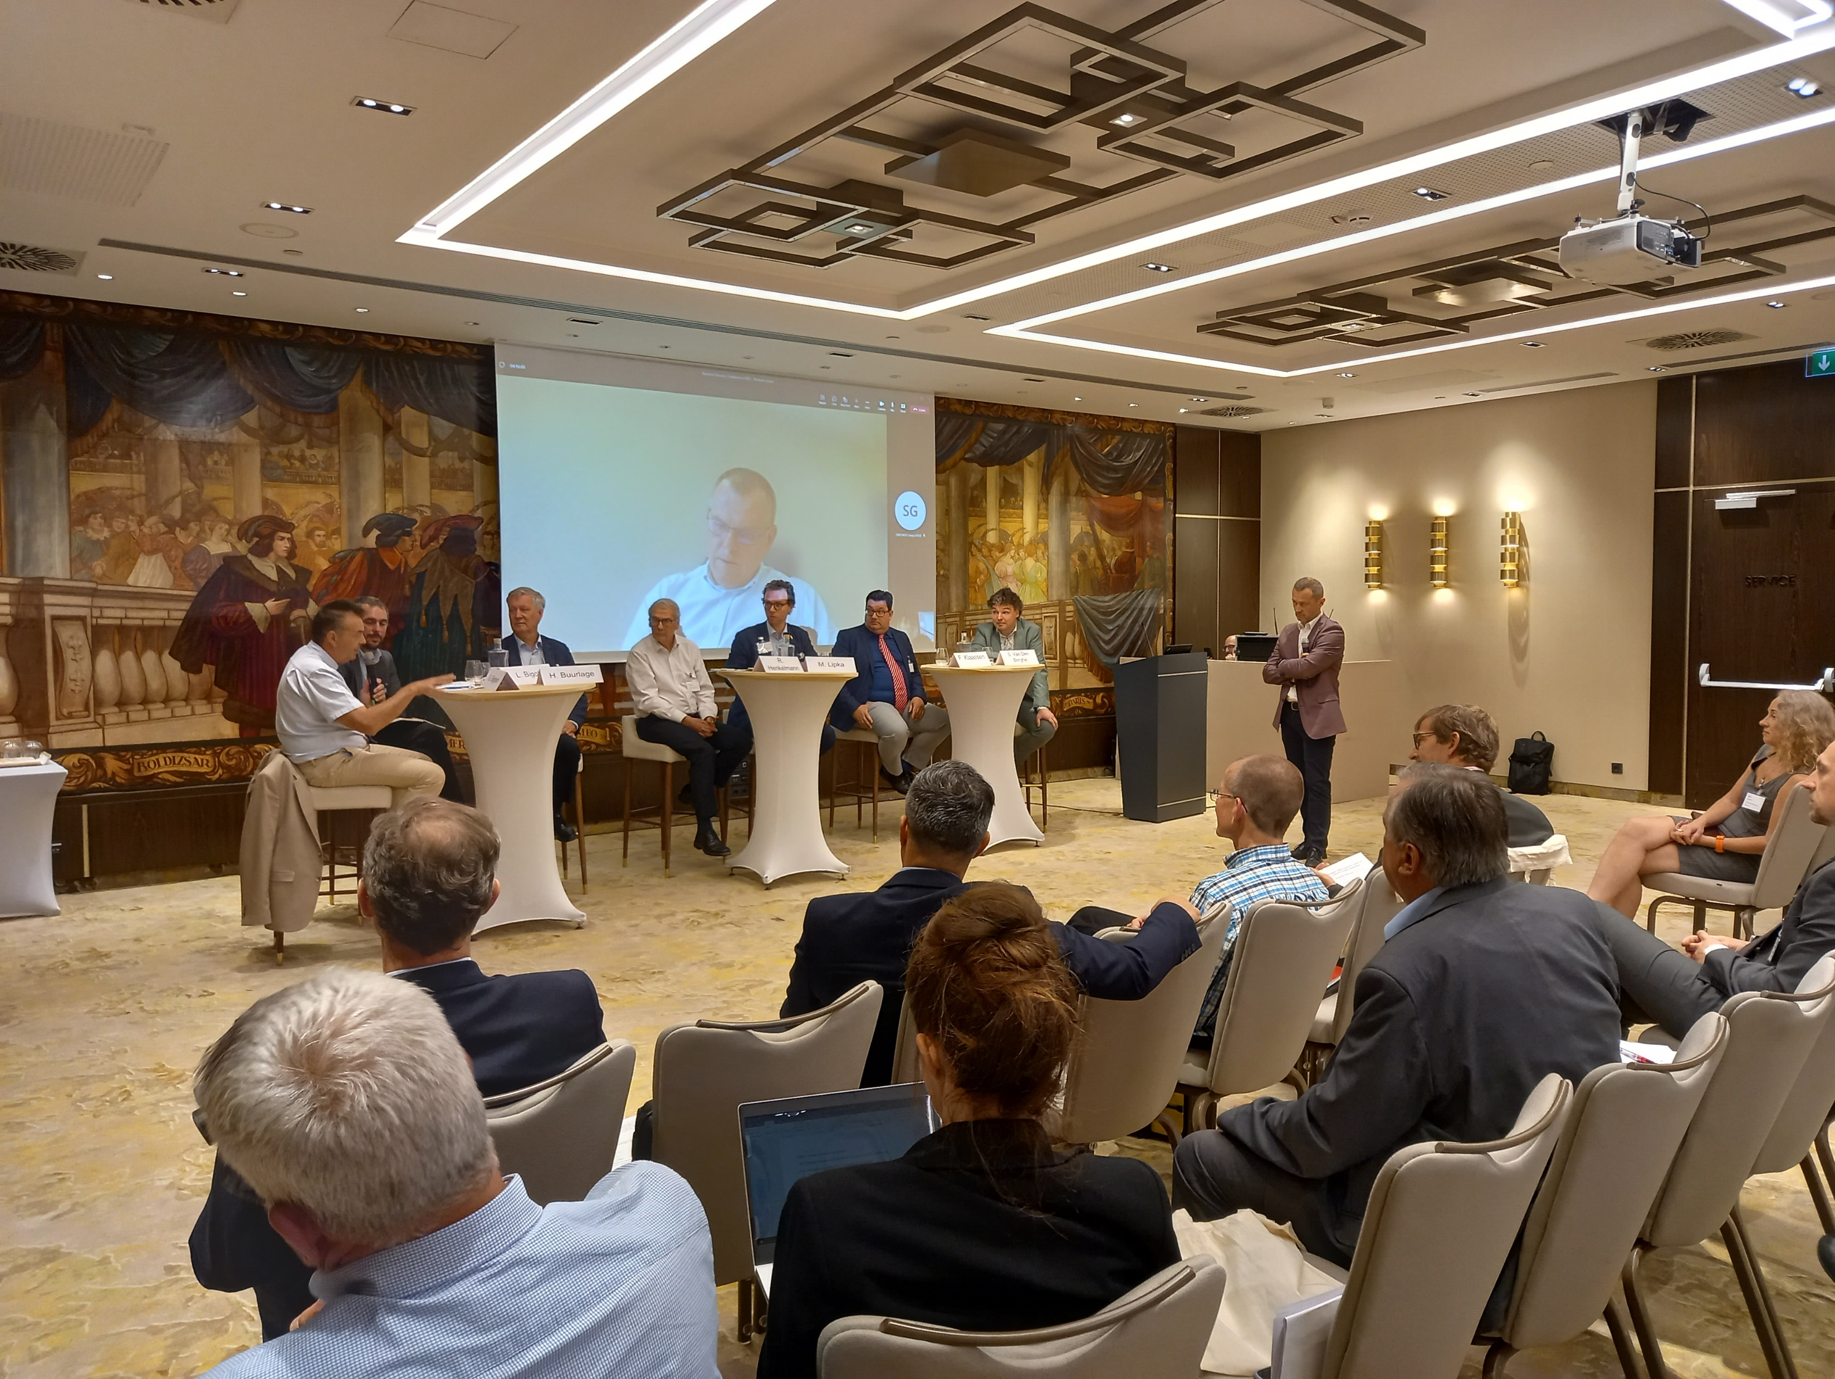
Presentation
The future of nuclear investment in Europe
in a context of global instability and geopolitical change
Brussels, 13th October 2022
Les Entretiens Européens 2022
European Nuclear Society

Slide 2
Who we are?
Presentation
Founded in 1975, ENS is the largest society for nuclear science, research and industry in Europe.
ENS gathers 21 nuclear societies and more 12,000 professionals in Europe.
ENS promotes the development of nuclear science and technology and the understanding of peaceful nuclear applications.

Slide 3
Supporting Scientific Excellence
Presentation
30 Corporate Members

Slide 4
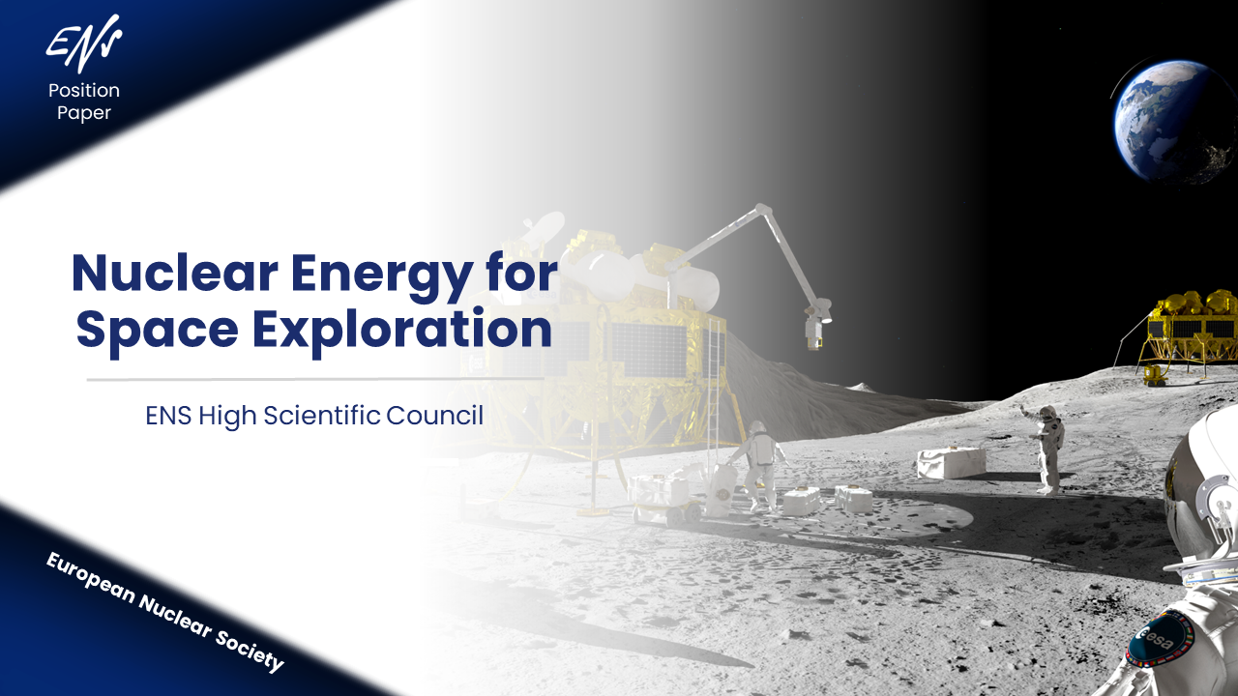
The ENS High Scientific Council
Presentation
23 scientists of high repute from 16 European Countries
ENS PhD Award
Position Papers

Slide 5
The ENS Climate Advocacy since 2015
Presentation

Slide 6
Financing Nuclear Energy
Presentation
Unique characteristic for investors:
Technical complexity
Political and regulatory risks
Liabilities
High fixed to variable cost ratios
The Development Bank of Latin America is the only development bank to have made a loan
in recent times (2013). The World Bank does not currently allow financing support for nuclear power.

Slide 7
Presentation
What can we learn from the past in the time of crisis?
What new opportunities are coming for the European electricity market?
How to boost investment in nuclear projects?
How to strength cooperation between Member States opting for nuclear power ?
What solutions against global warming?

