Slide 1
Les Entretiens Européens
20ème édition
Dinara Ermakova

Slide 2
400 GW increase by 2050
1 GW LWR directly employs at any given point:
Site preparation and construction (10 yr): 1200 people;
Operation: 600 people;
Decommissioning (10 yr): 500 people;
nuclear waste management (40 yr) - 80 people

Slide 3
Challenges in training and employment
Transfer of knowledge
Educational infrastructures
Security
Education cost

Slide 4
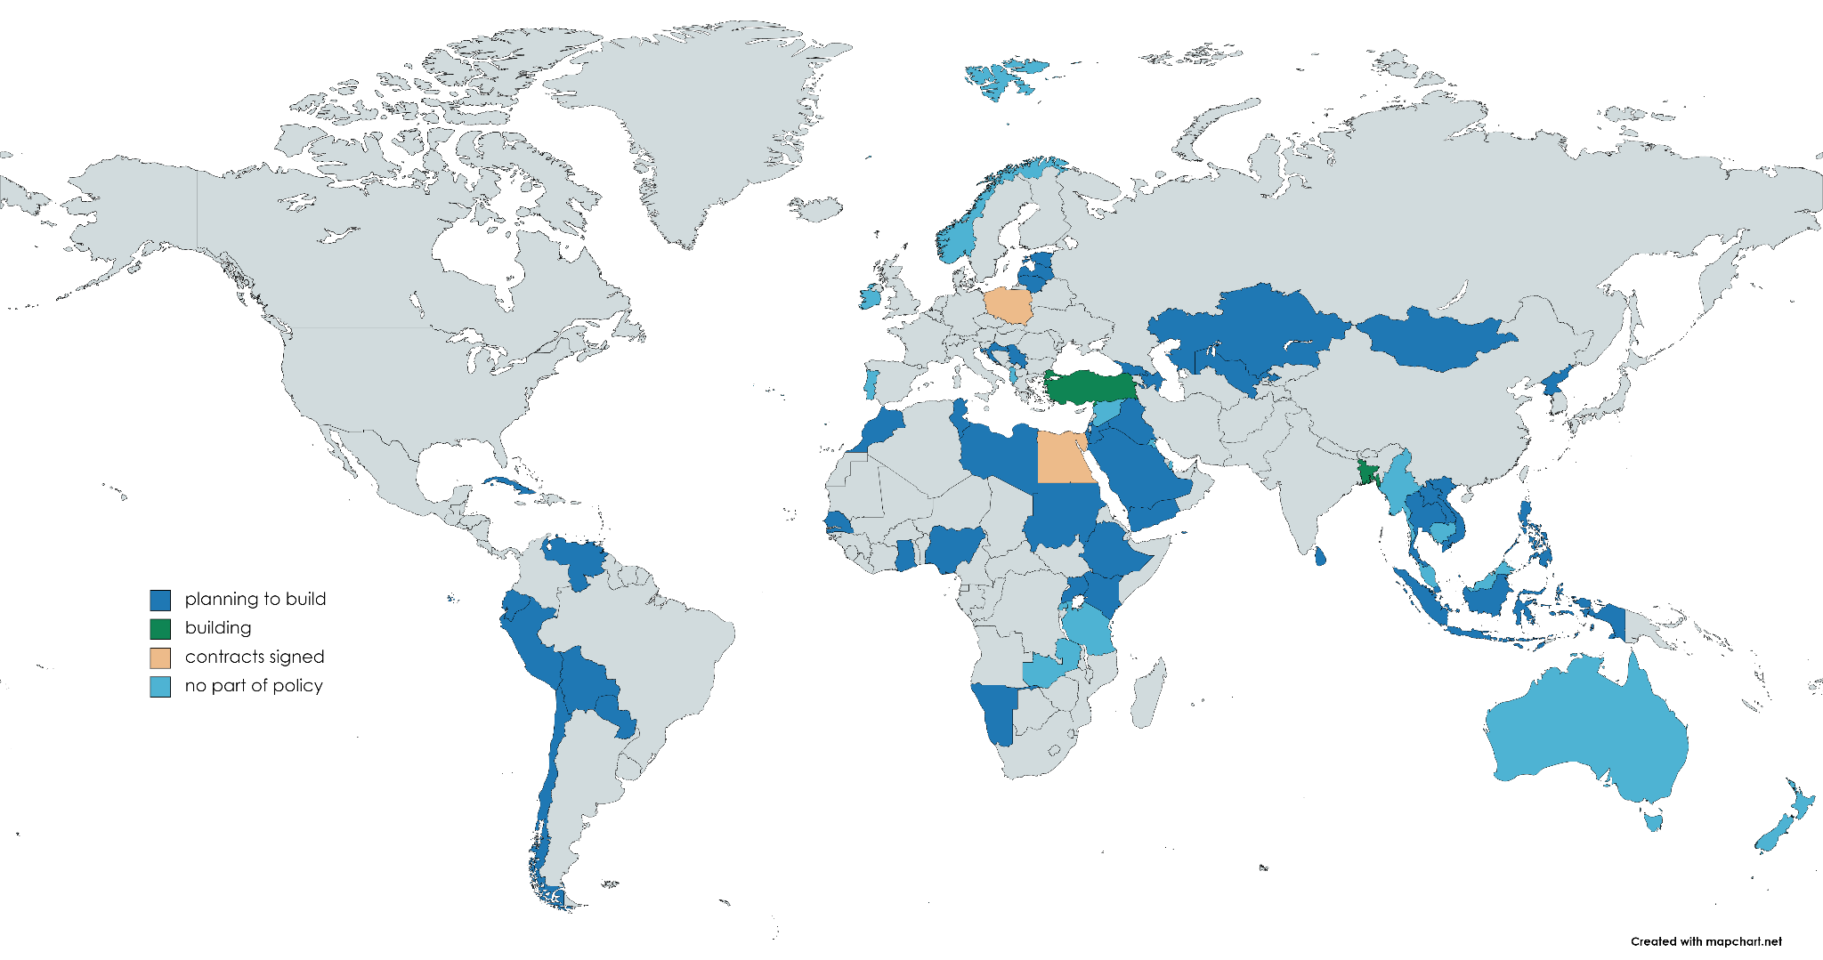
Nuclear power newcomers
Notes:
They must be able to use all their resources, including uranium, and benefit from technology transfers. Another issue is that of licensing reactor designs. Emerging countries generally do not have the expertise for this, and must initially rely on design licensing by countries such as the UK, USA, France, Russia and China while they focus on building competence to license the actual operation of plants.
electrification - which is a small part of energy mix, 80% fossils, 20% is electricity, 25 is nuclear

Slide 5
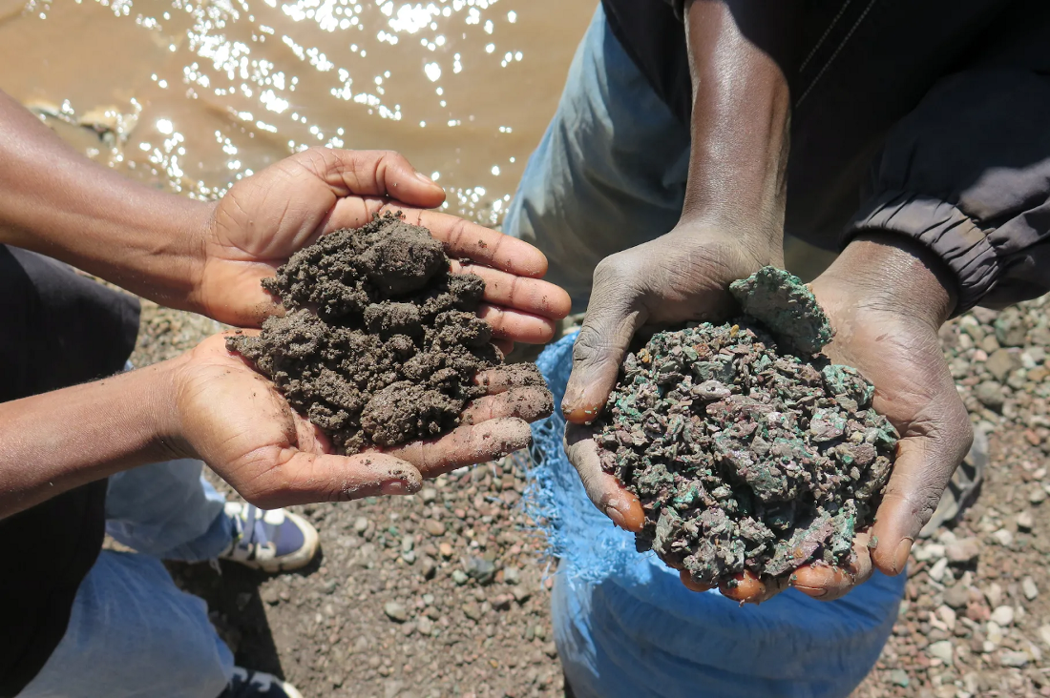
Material need for energy infrastructures
Raw cobalt in the DRC (Amnesty International)

