Slide 1


The role of nuclear energy in security of supply and climate protection in Europe
Prof. Dr. Attila ASZÓDI, Bence BIRÓ
Budapest University of Technology and Economics
Faculty of Natural Sciences
Institute of Nuclear Techniques
Les Entretiens Européens,
Zoom, 13.10.2022

Slide 2
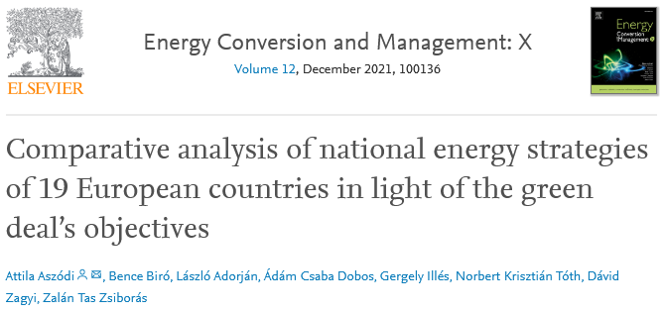
Our latest numerical studies
How suitable are the energy policies of Hungary and the surrounding countries to deal with the current (pre-war) situation?
What are the risks of high import exposure in the short, medium and long term?
Is the power plant fleet suitable and able to meet the challenges?
Climate protection - Fit for 55?
Are security of supply requirements met?
https://doi.org/10.1016/j.ecmx.2021.100136

Slide 3
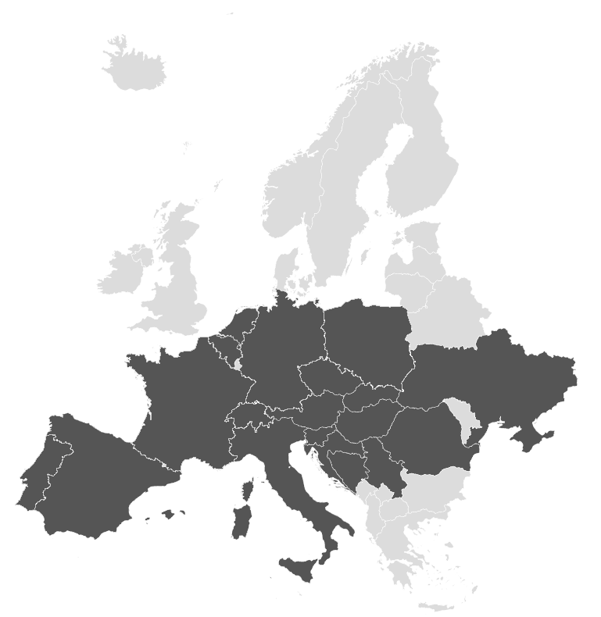
Investigated domain
Hungary, its neighbours and continental Europe (19 countries in total in this analysis)
Hourly resolution simulations for 2030 and 2040
  Examining the difference between annual energy balances or reference period calculations and hourly resolution simulations
Starting point:
  2019 real data
    MAVIR (HUN TSO)
    ENTSO-E
  National Energy and
  Climate Plans (NECP)
NL
BE
DE
PL
CZ
SK
UA
FR
CH
AT
HU
HU
SI
SI
RO
IT
HR
PT
ES
BA
RS

Slide 4
Countries and energy strategies examined
Country |  | Institution issuing the referenced energy policy document | Title of the energy policy document containing the data used | Year of publication
Austria | AT | Federal Ministry of Sustainability and Tourism | Integrated National Energy and Climate Plan for Austria | 2019
Belgium | BE | Coordination Committee for International Environmental Policy, National Climate Commission | Belgian Integrated National Energy and Climate Plan 2021 - 2030 | 2019
Bosnia and Herzegovina | BA | SEERMAP: South East Europe Electricity Roadmap | Country report: Bosnia and Herzegovina 2017 | 2017
Croatia | HR | Ministry of Environment and Energy | Integrated National Energy and Climate Plan for the Republic of Croatia for the period 2021-2030 | 2019
Czech Republic | CZ | Ministry of Industry and Trade, Ministry of the Environment | National Energy and Climate Plan of the Czech Republic | 2019
 |  | Czech Transmission System Operator | Assessment of generation adequacy of the CR electricity system until 2030 | 2017
France | FR | Government of France | Integrated National Energy and Climate Plan for France | 2020
Germany | DE | Federal Government of Germany | Integrated National Energy and Climate Plan | 2019
Hungary | HU | Ministry of Innovation and Technology | National Energy and Climate Plan | 2020
Italy | IT | Ministry of Economic Development, Ministry of the Environment and protection of Natural Resources and the Sea, Ministry of Infrastructure and Transport | Integrated National Energy and Climate Plan | 2019
 |  | Cassa Depositi e Prestiti | The energy transition in Italy and the role of the gas and power sectors | 2019
Netherlands | NL | Ministry of Economic Affairs and Climate Policy | Integrated National Energy and Climate Plan 2021-2030 | 2019
Poland | PL | Ministry of National Assets | The National Energy and Climate Plan for 2021-2030 | 2019
Portugal | PT | Ministry of Environment and Energy Transition | Roadmap for carbon neutrality 2050 | 2019
Romania | RO | Ministry of Economy, Energy and Business Environment | The 2021-2030 Integrated National Energy and Climate Plan | 2020
Serbia | RS | SEERMAP: South East Europe Electricity Roadmap | Country report: Serbia 2017 | 2017
Slovakia | SK | Ministry of Economy | Integrated National Energy and Climate Plan for 2021 to 2030 | 2019
 |  | Donato de Rosa, The World Bank: Macroeconomics, Trade and Investment Global Practice | A Low-Carbon Growth Study for Slovakia: Implementing the EU 2030 Climate and Energy Policy Framework | 2019
Slovenia | SI | Republic of Slovenia | Integrated National Energy and Climate Plan of the Republic of Slovenia | 2020
Spain | ES | Ministry for Ecological Transition and Demographic Challenge | Integrated National Energy and Climate Plan 2021-2030 | 2020
 |  | Ministry for Ecological Transition and Demographic Challenge | Estrategia de Descarbonización a Largo Plazo 2050 - Anexos | 2020
Switzerland | CH | Federal Department of the Environment, Transport, Energy and Communications | The energy perspectives for Switzerland until 2050 | 2012
Ukraine | UA | KPMG International | Renewables in Ukraine | 2019

Slide 5
Annual input data - Installed capacity
827 734 MW
2019
1 134 128 MW
2030
1 430 397 MW
2040
Breakdown by energy source

Slide 6
Annual input data - Change in consumption

Slide 7
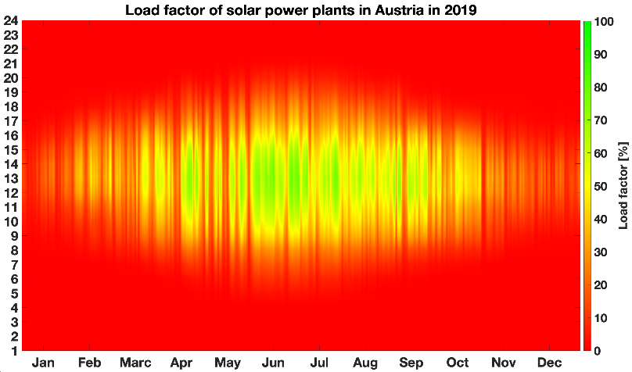
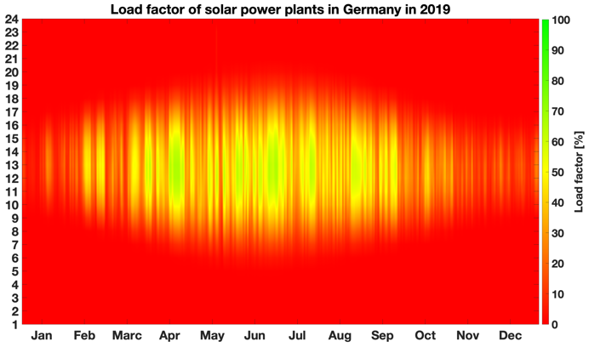
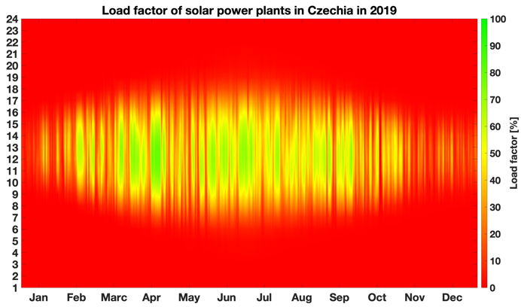
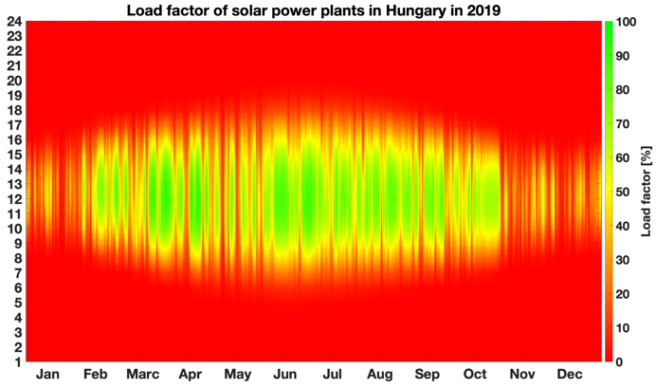
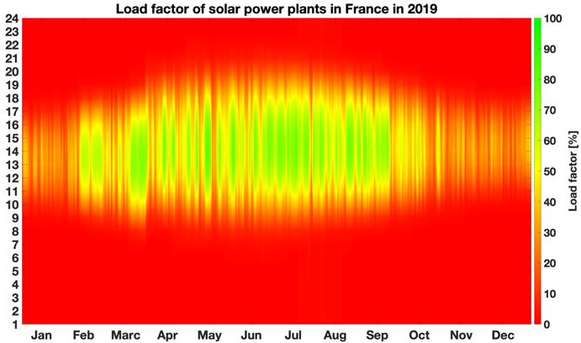
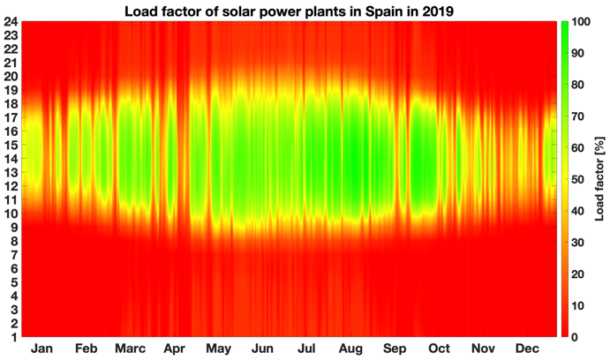
Input hourly data - Solar production

Slide 8
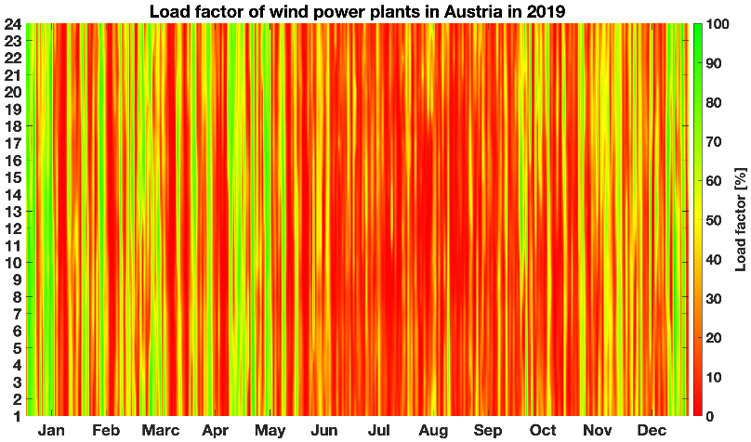
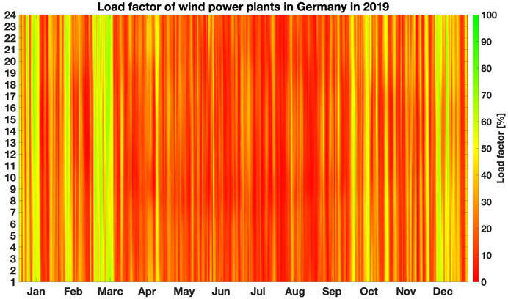
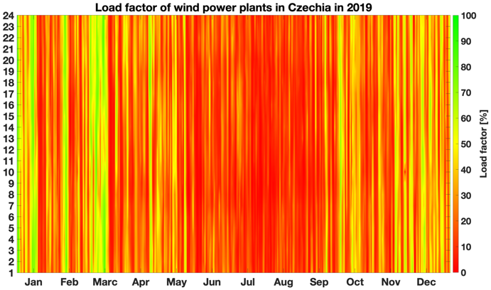
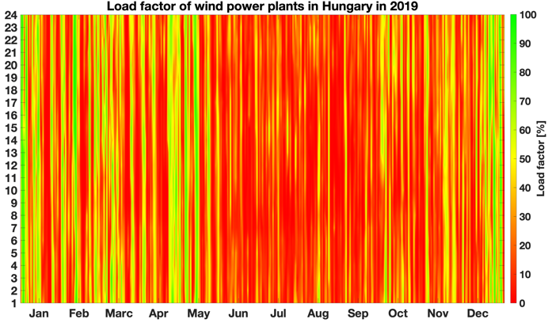
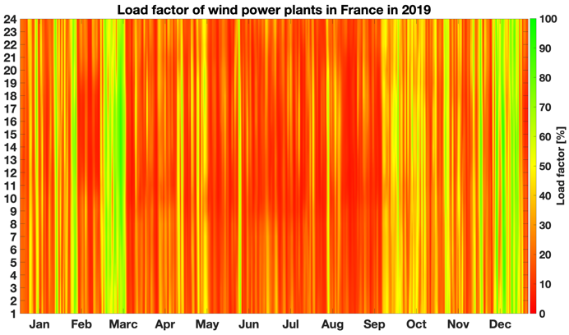
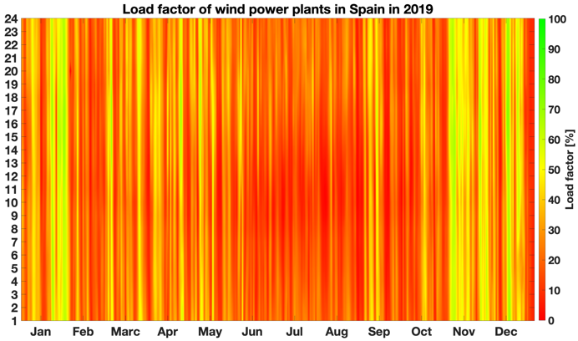
Input hourly data - Wind production

Slide 9
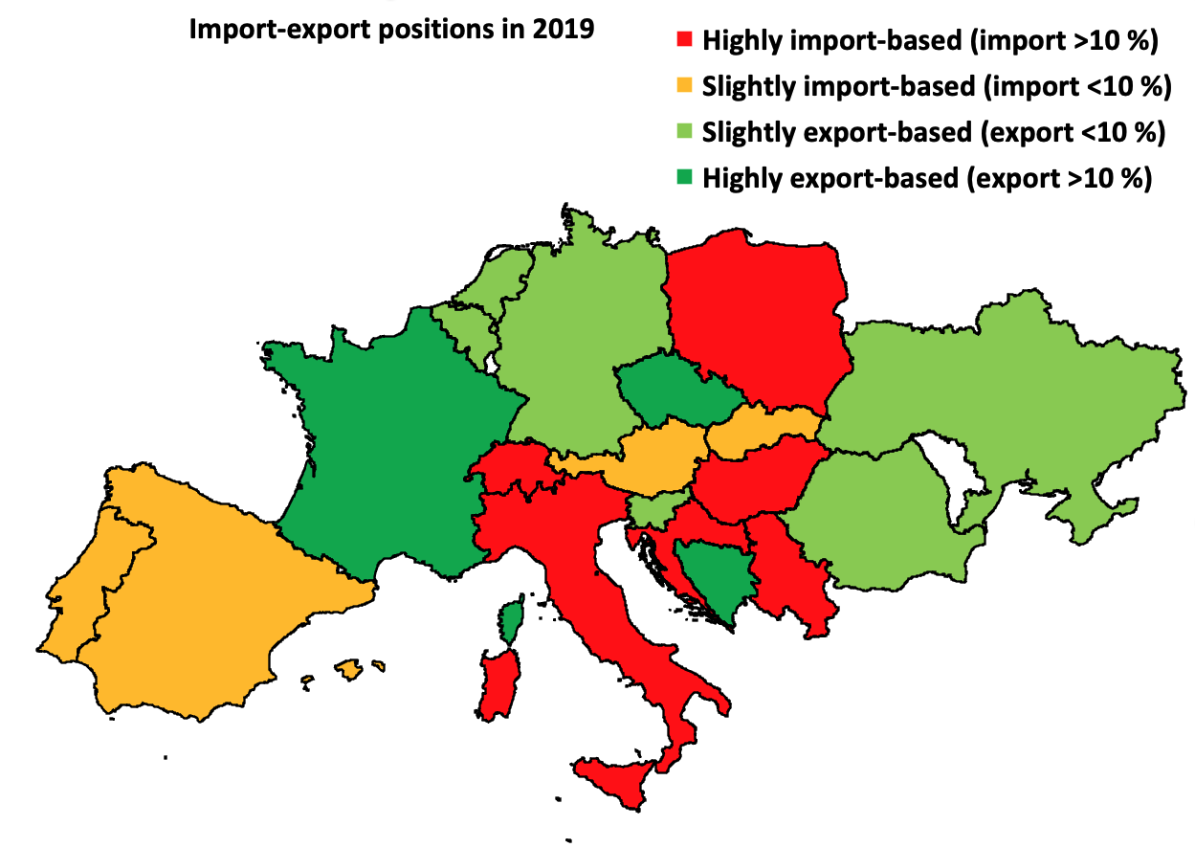
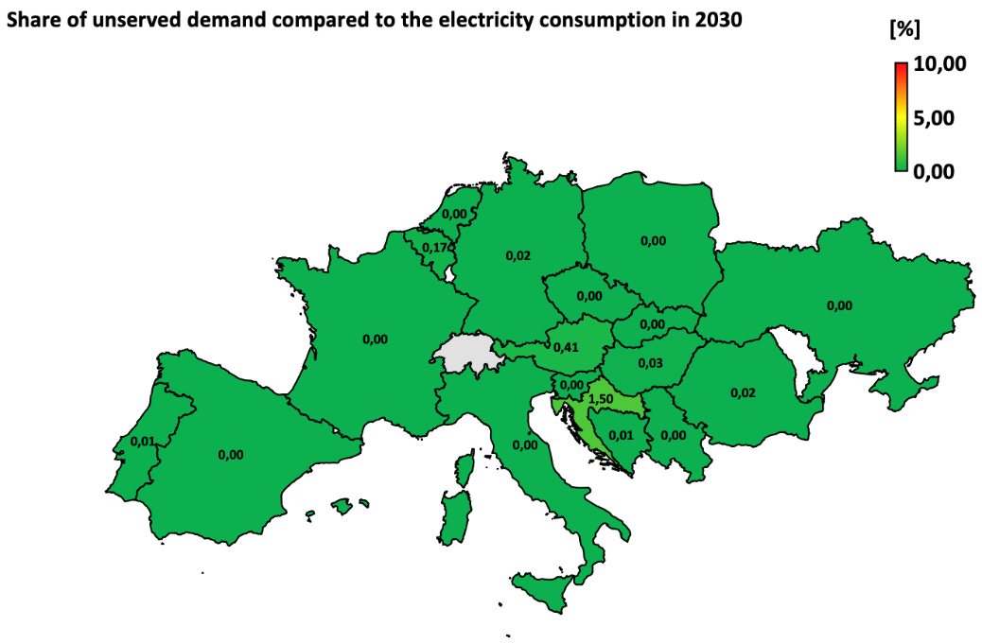
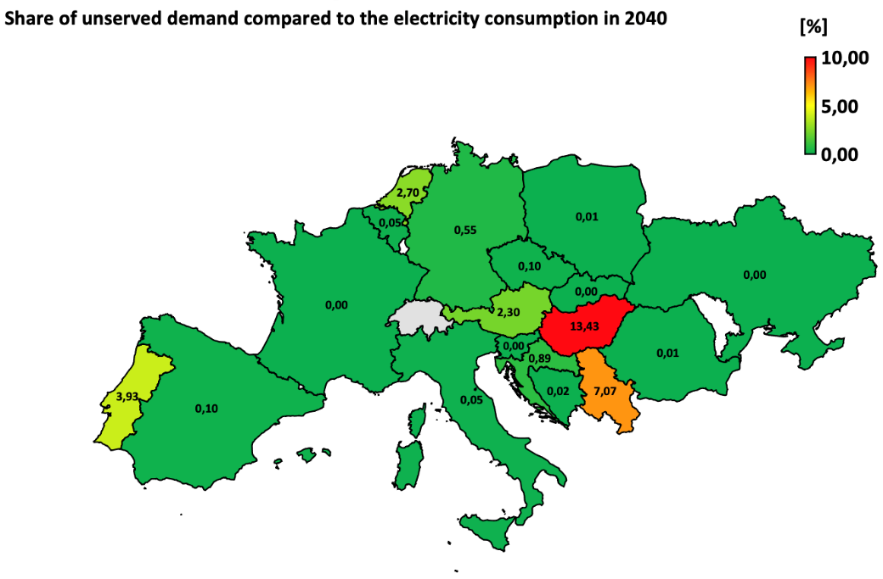
Unserved energy
(Taking all available energy sources into account)

Slide 10
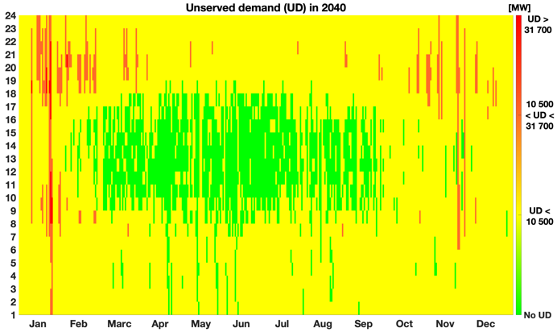
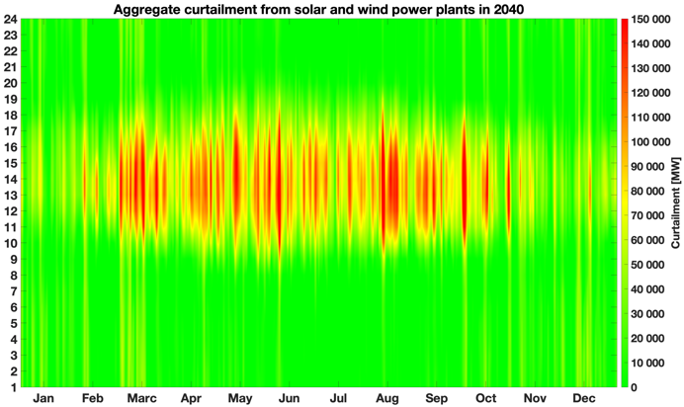
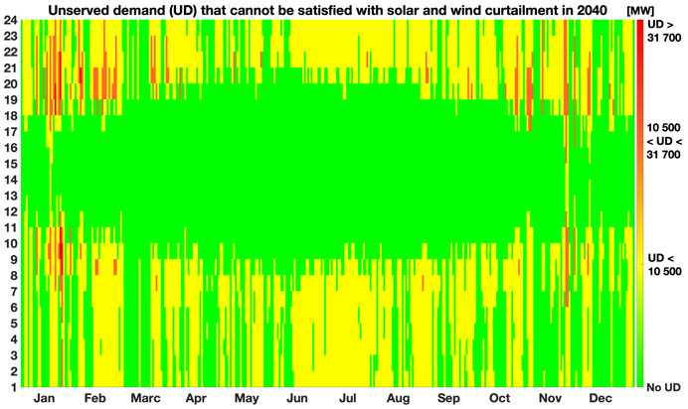
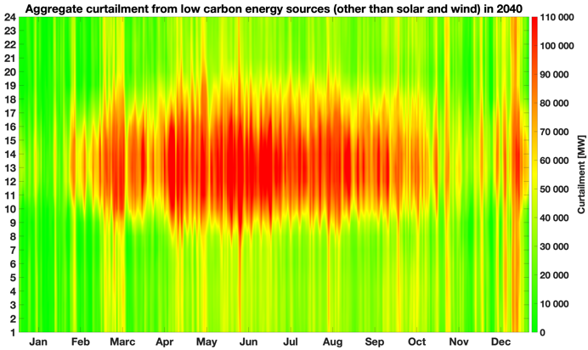
Unserved energy and forced plant generation reduction in the interconnected electricity system (2040)
No export-import
Unlimited cross-border capacities for solar and wind
Hydro, nuclear, geothermal, biomass, waste included
Notes:
Jobb alsóban: víz, nukleáris, geotermikus, biomassza, szemét

Slide 11
Carbon-neutral electricity generation

Slide 12

Summary of results and lessons learned
Redesign!
Our simulation shows that the energy strategies of the European countries under study are not well suited to meet climate and security of supply objectives. The redesign of energy strategies is necessary.
The situation has been further worsened by the increased security of supply, foreign policy and national security risks posed by the Russia-Ukraine war
The taxonomy regulation contains restrictions that were already challenging without the war
The impact of the economic crisis
on European countries caused
by the climate crisis and the
COVID pandemic is dramatically
worsened by Russia's war in Ukraine
There is a clear need to revitalise the European nuclear industry
Development and introduction of new energy technologies is essential
Source: https://twitter.com/BBK_Bund/status/1443516558232461314

