Slide 1
Entretiens européens – Octobre 2022
Armand Laferrère, Senior Vice President of Government Affairs

Slide 2
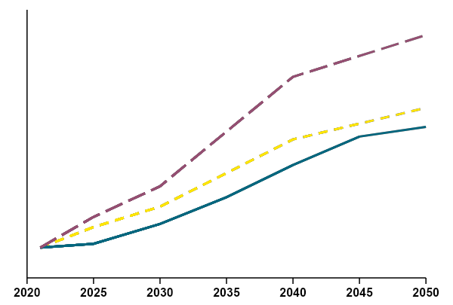
A resilient business model behind the Orano group’s development
Global nuclear capacity is set to grow, driven by electricity needs…
… confirming the group's drivers for growth, both in the Front End and the Back End
The increase in the number of reactors in operation generates growth in:
Accessible Mining and Front End markets (demand for uranium, conversion & enrichment)
Accessible markets in the Back End of the cycle (management of used fuels, logistics)
Moreover, the group is also positioned in end-of-cycle services with waste management and the dismantling of nuclear facilities.
Net global nuclear capacity (Orano 2021 baseline scenario), in net gigawatts (GWe)
GWe net
IEA Net Zero Emissions Scenario (2021), to fully decarbonize energy by 2050
850
WEO 2021 - Sust. Dev.
800
Orano 2021 - Baseline
771
750
IEA 2021 - Net Zero
732
IEA WEO Sustainable Development Scenario (2021) to limit global warming to +2°C
700
694
650
636
600
591
577
606
600
Orano baseline scenario (2021) with + 1.6% growth per year
To meet the commitments of the Paris Agreement, we have to speed up deployment of new installed nuclear capacity.
550
582
500
489
514
529
CAGR
1,6%
450
451
469
400
419
375
382
375
Source: Orano analyses

Slide 3
... and right across all service activities
Ensure excellence right across the fuel cycle…
Nuclear Packages & Services
Engineering
The Group offers its customers efficient products and services, right across the cycle, from mining through to decommissioning, as well as in conversion, enrichment, recycling, logistics and engineering.
Orano is also a major player in nuclear medicine and targeted alpha therapy with ²¹²Pb, thanks to the work of its Orano Med subsidiary.
Decommissioning & Services

