Slide 1
International cooperation OVERVIEW at Andra
Notes:
Pour modifier la date et la référence Socrate en en-tête et pied de page de toutes les diapositives :
=> Onglet [Insertion] | En-tête et pied de page
- Dans le champ "Fixe", remplacez "jj mmmm aaaa" par la date et cochez la case "Date et heure"
- Dans le champ "Pied de page", modifiez la référence Socrate et cochez la case
- Vous pouvez également ajouter le numéro de diapositive en cochant la case associée
- Cliquez sur le bouton [Appliquer partout]

Slide 2
Radioactive waste and their disposal solutions in France
Concept & Siting
Design & Licencing
Construction & Operation
Closure & Monitoring
Volume %
Radioactivity level
VLLW
Cires
LILW-SL
CSA
LILW-SL
CSM
LLW-LL
ILW-LL HLW
Cigeo
> 90% of Radioactive Waste has a disposal solution

Slide 3
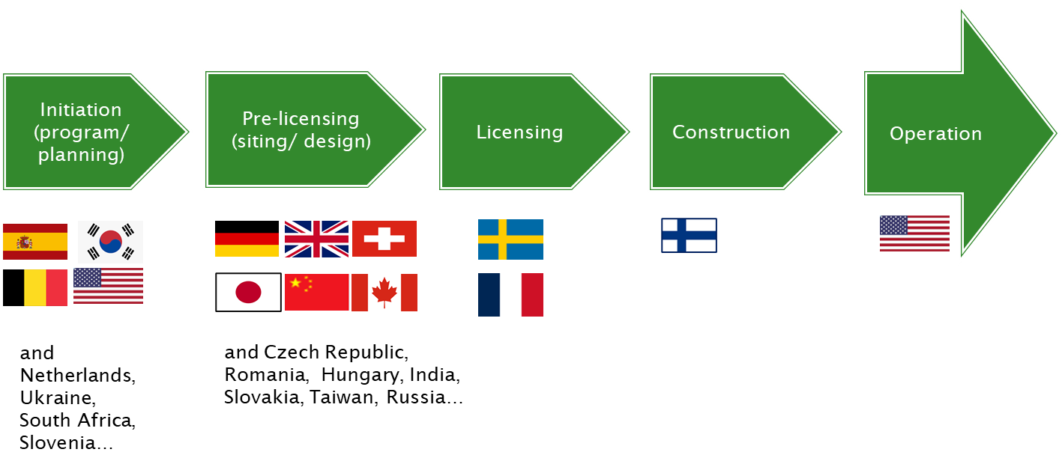
Focus on Cigéo project
Political Decision process started in 1991and based on Laws and Acts
Disposal of all HLW and ILW-LL from currently licensed nuclear installations
Opt-in based site selection (Meuse/Haute-Marne district in 1998)
Supported by an Underground Research Laboratory (since 2000)
Reversible disposal process for at least 1 century
Industrial Pilot Phase

Slide 4
International cooperation
IAEA
OECD/NEA
EURAD
EDRAM
Bilateral cooperation
Notes:
Lien vers la banque d’images : L:\Formulaires_ANDRA\Andra ModelePresentation_version_2018

Slide 5
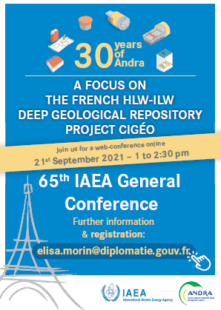
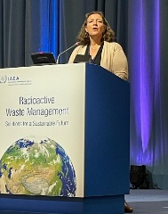
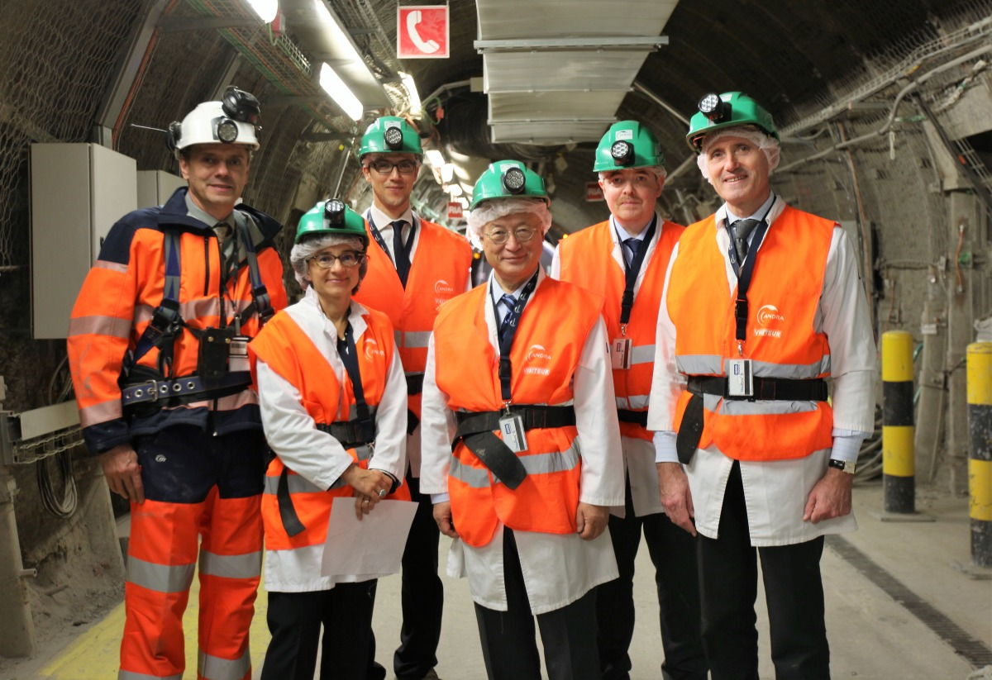
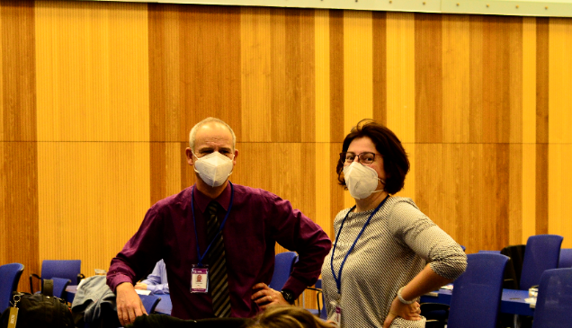
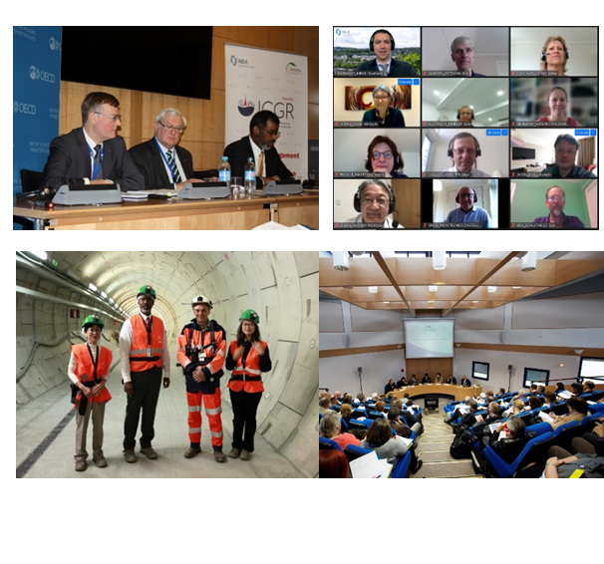
Institutional cooperation with IAEA and NEA
Sharing scientific, technical information, experience and knowledge with member states
>170 countries
Contribute to safe and peaceful use of nuclear science and technologies - international standards
International conventions, Conferences
Networks and working groups, Fellowship, Scientific visits
…
~ 40 countries
Cooperation among countries with advanced nuclear technologies infrastructures
Working parties, experts groups, int’l joint projects
Conferences
Notes:
Pour mettre des mots en exergue : gras + couleur
-----------------------------------------------------
Police courante : Lucida Sans

Slide 6
Institutional cooperation with EDRAM
INTERNATIONAL ASSOCIATION FOR ENVIRONMENTALLY SAFE DISPOSAL OF RADIOACTIVE MATERIALS
Implementers forum where strategic questions can be discussed
promote a common implementers understanding of waste management issues
stimulate and promote coordinated research and development activities
define positions and coordinate actions
discuss on management to benchmarking and establishing optimum practices
11 Implementers
Chair :
Pierre-Marie ABADIE – CEO of Andra
Techn. Secretary :
Daniel DELORT – Head of International Affairs at Andra
Notes:
Pour mettre des mots en exergue : gras + couleur
-----------------------------------------------------
Police courante : Lucida Sans

Slide 7
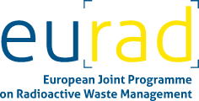
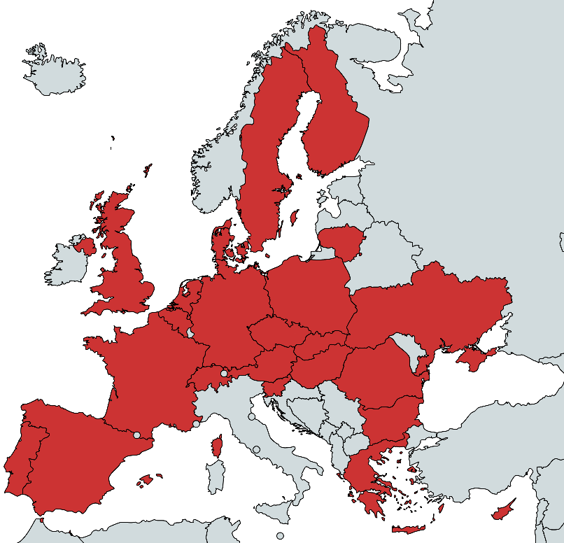
Institutional cooperation with EU
European Joint Programme on Radioactive Waste Management EURAD
Objectives :
- Implement a robust and sustained state-of-the-art Science and Technology Programme
- Identify and elaborate upon complex issues by bringing together interested actors to jointly conduct Strategic Studies
- Consolidate efforts across Member-States, organisations and generations on Knowledge Management
- Foster mutual understanding and trust between participants (incl. from Civil Society) and other stakeholders
5 years
2019-2024
59,9 M€
50 %EC contribution
10 R&D WPs
Ministries from 23 European countries recognising their role of directing RD&D at the national level, provided mandates to 51 organisations acting as Beneficiary within EURAD:
Waste Management Organisations
Technical Support Organisations
Research Entities
… with 64 linked third parties & 3 international partners
2 Strategic Studies
3 Knowledge Management WPs
Notes:
Pour mettre des mots en exergue : gras + couleur
-----------------------------------------------------
Police courante : Lucida Sans

Slide 8
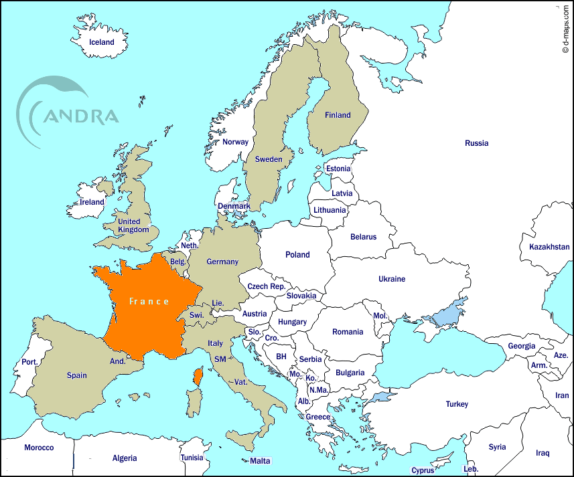
Bilateral cooperation – with who ?
With the most advanced foreign organizations in charge of radioactive waste management:
Plus, Canada (NWMO), Japan (NUMO), USA (US-DOE)
Broad scope of subjects :
Scientific:
Site characterization programs,
Measurement, testing and modelling of geological environments, radionuclides transport,…
Technical:
Waste characterization, design, construction, and operation of final disposal facilities
Cross-cutting topics:
Programme governance, stakeholder involvement, consultation and public acceptance, knowledge and data management
Notes:
Pour mettre des mots en exergue : gras + couleur
-----------------------------------------------------
Police courante : Lucida Sans

Slide 9
Conclusion
Cooperation on radioactive waste management is :
Worldwide issue
Well structured and active: international cooperation programs (IAEA, OECD-NEA, EU…)
With also privileged partnerships/cooperation agreements (bilateral and multilateral cooperation, EDRAM)
Notes:
Pour mettre des mots en exergue : gras + couleur
-----------------------------------------------------
Police courante : Lucida Sans

