Slide 1
Agreement among EU states on the creation of an industrial sector
Is cooperation possible?
Yves Desbazeille, Director General – FORATOM
14 October 2021

Slide 2

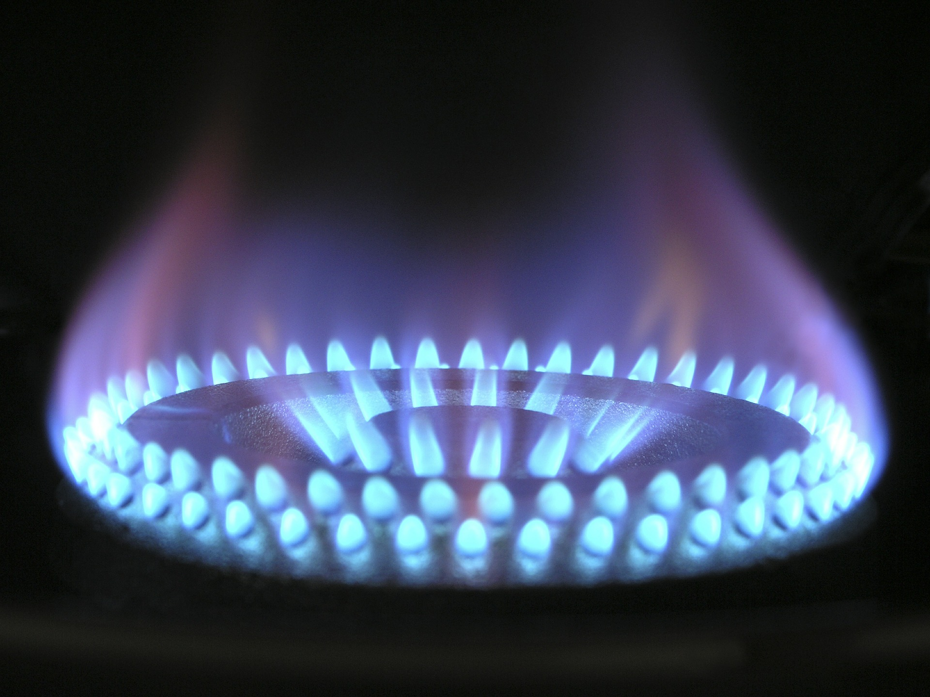
CURRENT ENERGY CRISIS

Slide 3
Price increases
Increase in gas prices
Increase in coal prices
Increase in carbon price under EU-ETS
Low-renewable production

Slide 4
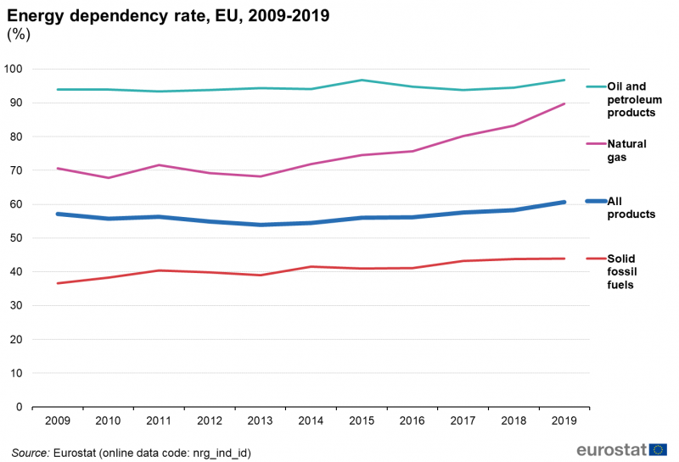
Security of Supply: Import dependence
2019 energy dependence rate:
Crude oil: 96.8 %
Natural gas: 89.7 %
Solid fossil fuels: 44%
Europe is facing not only an increase in gas prices but also a security of supply issue

Slide 5
Security of supply: Less renewables
H1 2021: Lower renewable production than expected in Europe due to:
  Low wind availability
  Dry season affecting hydropower output

Slide 6
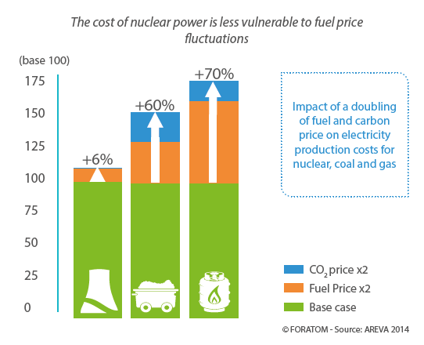
Potential solutions
Short term:
Avoid nuclear power plant closures. This will help ensure
  Stable power prices
  Security of supply
Medium & long Term:
Value nuclear power production by including it in all relevant policies
Invest in nuclear R&D and promote technologies which consume less uranium
Reform the markets to better reflect the value of security of supply and full system costs

Slide 7








Nuclear: more than just power
Energy
Science
Health
Agriculture
Nuclear
Industry
Food
Space
Water /
Desalination

Slide 8
Nuclear industry structure
Supply Chain
Regulators
Output
LT benefits
Tier 1
Tier 2
System integrators
Tier 3
Original equipment manufacturers
Tier 4
Sub-component suppliers /distributors
Tier 6
Tier 5
Processors/fabricators
Raw material suppliers/miners
Technology vendors
Low carbon power
Reliability
Dispatchability
Competition
Construction
Nuclear Power Plant
Competitive economy
Energy transition
Research reactors
Maintenance
Back end circular economy
Recycling
Decommissioning
Waste management (treatment reduction, repositories)
Circular Economy Compliance
Fuel supply
(front - end)
Improve design
Safety efficiency
Medical isotopes
other applications (chipsets, space)
Prepare for the future
Ensure energy independence
Human Capital: skills (up/reskill) & attract young talent to nuclear related profession

Slide 9
Nuclear power industry’s contribution to EU
€576
bn
€507
bn
In EU GDP
2019
2050
1,1
mn
Jobs sustained by the nuclear industry
1,3 mn
Of which are highly skilled
45%
47%

Slide 10
2030: 1 TWh produced electricity generates
Source: Deloitte calculations

Slide 11










Future nuclear applications for industry
DISTRICT HEATING
INDUSTRY
LARGE REACTORS
HYDROGEN
SMALL MODULAR REACTORS
H2
POWER
&
HEAT
CLEAN WATER
MICRO REACTORS
ADVANCED REACTORS
NEW CHEMICAL PROCESSES

Slide 12
Future of nuclear in the EU
In the 2015-2025 period, more than 50 GW of nuclear capacity is
at risk of early closure - equivalent to the new RES production
expected => no progress at all on the EU decarbonisation pathway
‘Under construction’ capacity
‘Under construction & planned’ capacity
‘Optimum’ scenario
*Source: PINC, European Commission, 2017
Estimated investment needs in LTO (until 2050): EUR 46,9 billion

Slide 13
Key industrial challenges
Deliver the required volume of nuclear capacity on time and at a competitive cost
Render the supply chain more competitive and better performing
Invest in and maintain human capital – render the industry more attractive to young people
Assess and implement the opportunities afforded by digitalisation
Strengthen R&D and innovation
Continue to develop and implement long-term waste solutions

Slide 14
Cooperation between Member States
How can MS work together to support nuclear at EU level?
Could an ‘energy solidarity pact’ be a potential solution?
Could strengthened cooperation on a European nuclear supply chain help to reduce costs?
What should the EU do to support such a supply chain?
Should we be looking to establish a nuclear industry cluster/alliance in Europe?

Slide 15



Thank you
www.foratom.org | foratom@foratom.org |

