Slide 1
B. Charmaison
Director I-Tésé Institute
Entretiens européens
Financing Research in the nuclear energy sector
13 October 2021 - Brussels
Notes:
I3P: programme tech-éco et cogénération (variante ANCRE et thèse Martin)
Topic 1.3
Total H2 et MCA

Slide 2
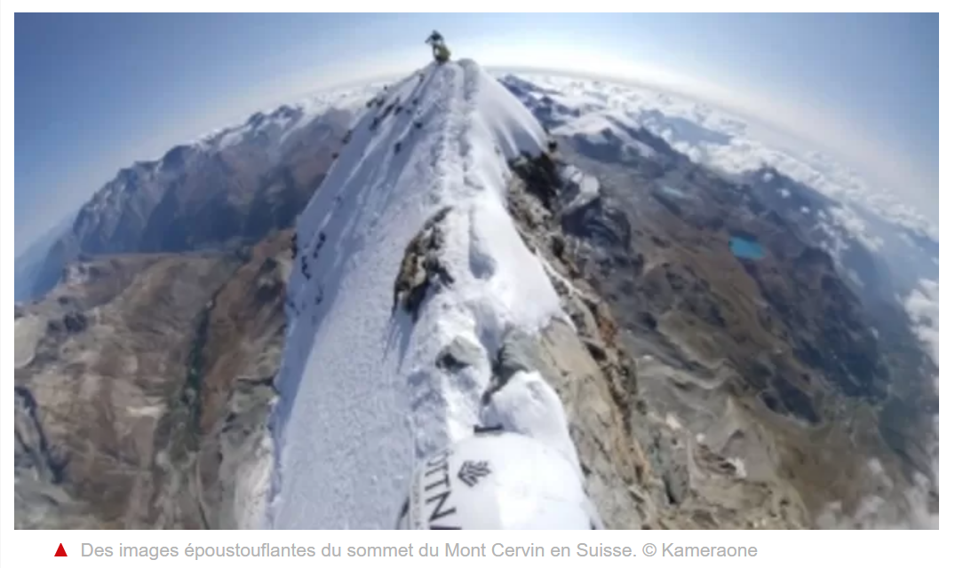
FINDING THE PATH TO A ZERO CARBON WORLD
https://youtu.be/iBiIZMaPcBQ

Slide 3
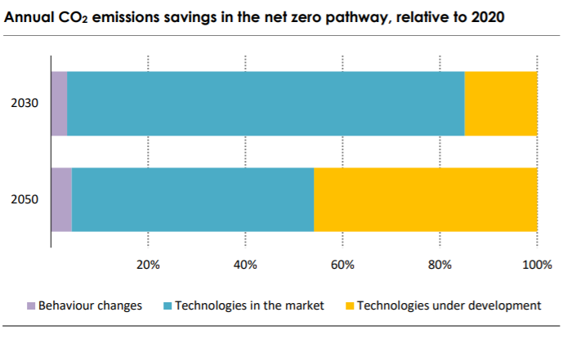
A SURGE IN RESEARCH EFFORTS IS NEEDED. NOW!
Scenario « net zero by 2050 » of International Energy Agency
About half of technologies needed are to be developed and raised to industrial scale
The coming decade is key : R&D spending should increase more than three times
from 25 bn$/y to 90 bn$/y
B. Charmaison – Oct. 21

Slide 4
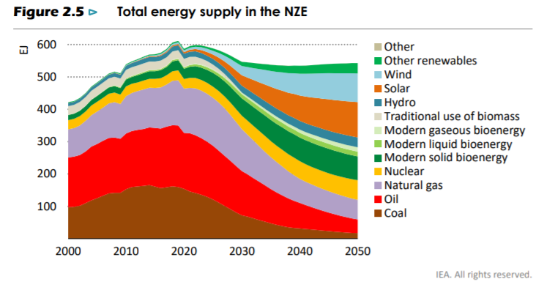
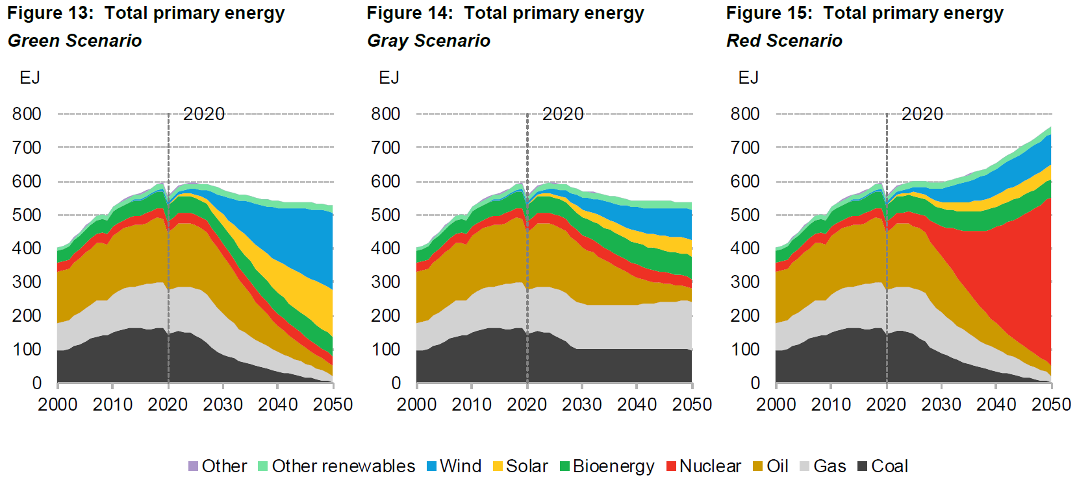
NUCLEAR ENERGY IS PART OF THE SOLUTION
IEA « Net zero by 2050 » scenario requires doubling nuclear production by 2050
For BNEF 2021 Energy Outlook, all scenarios needed to reach net zero by 2050 include nuclear. In its “red scenario”, there is a massive surge to produce low carbon H2.
Nota bene : nuclear is depicted in yellow in IEA and in red in BNEF
B. Charmaison – Oct. 21

Slide 5
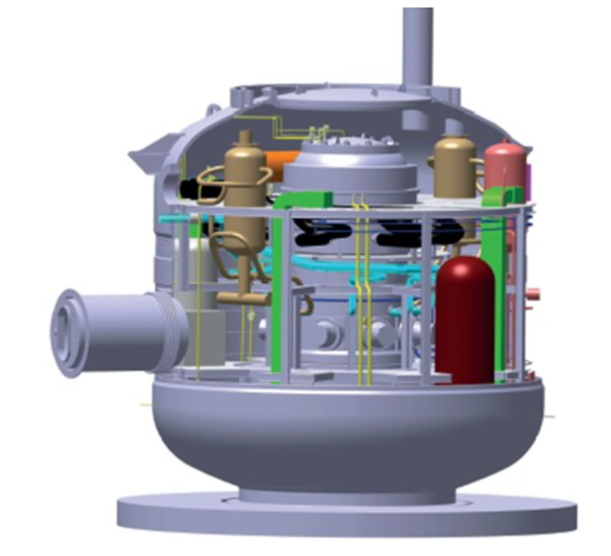
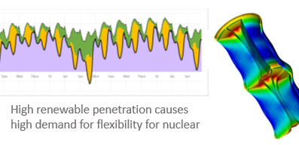
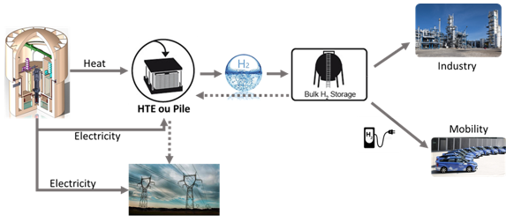
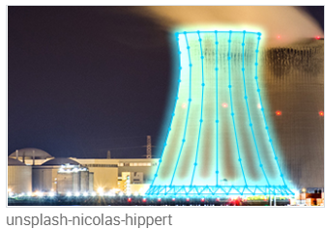
EXAMPLES OF RESEARCH IN NUCLEAR ENERGY SECTOR WITH A POSSIBLE IMPLEMENTATION AT SCALE BY 2050
SMR
NuwardTM
More Flexible nuclear fuels
Decarbonizing beyond electricity
IDNES Project (CEA)
Advanced simulation & digital twins
B. Charmaison – Oct. 21

Slide 6
RESEARCH IN THE NUCLEAR ENERGY SECTOR
Neutronics
Materials
Physics
Chemistry
Thermo-hydraulic
Mechanical Eng.
Additive manufacturing
Analytical science
Thermodynamics
Applied Maths
Numerical Analysis
Software design
IA
Economics
Industrial Organization
......
RESEARCH IN NUCLEAR ENERGY IS ACTUALLY DOING RESEACH IN :
WITH SIGNIFICANT SPILLOVERS TO OTHER SECTORS !
B. Charmaison – Oct. 21

Slide 7
FINANCING NUCLEAR RESEARCH : Are EU and US in the same league ?
EURATOM budget is down
While US DOE budget for nuclear R&D, already much larger, is set to double in just 5 years
B. Charmaison – Oct. 21

Slide 8
TO SUM UP
In order to successfully implement a transition towards zero carbon by 2050, R&D budgets need to be massively increased now.
Nuclear energy is widely seen as part of the solution to economically decarbonize our economies.
Euratom R&D budget for nuclear is going down for 2021–2025 period. Meanwhile, in other parts of the world, nuclear R&D budgets are strongly increasing.
B. Charmaison – Oct. 21

Slide 9
Thank you for your attention !

