Slide 1
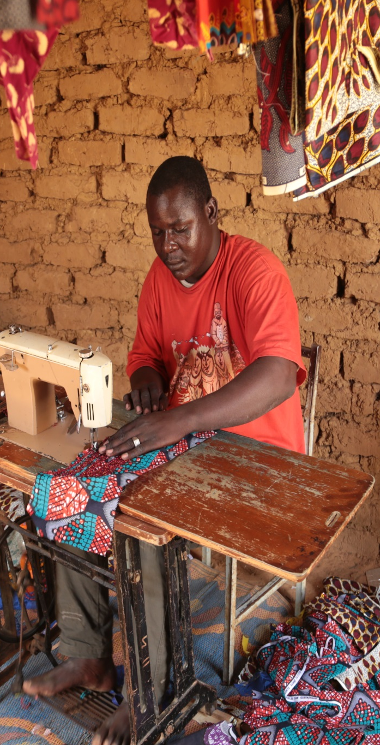

European Union Emergency Trust Fund for Africa
Involving African diasporas in supporting
Employment, Employability and Local productive investments
in Sahel and Lake Chad region
03/04/2019

Slide 2
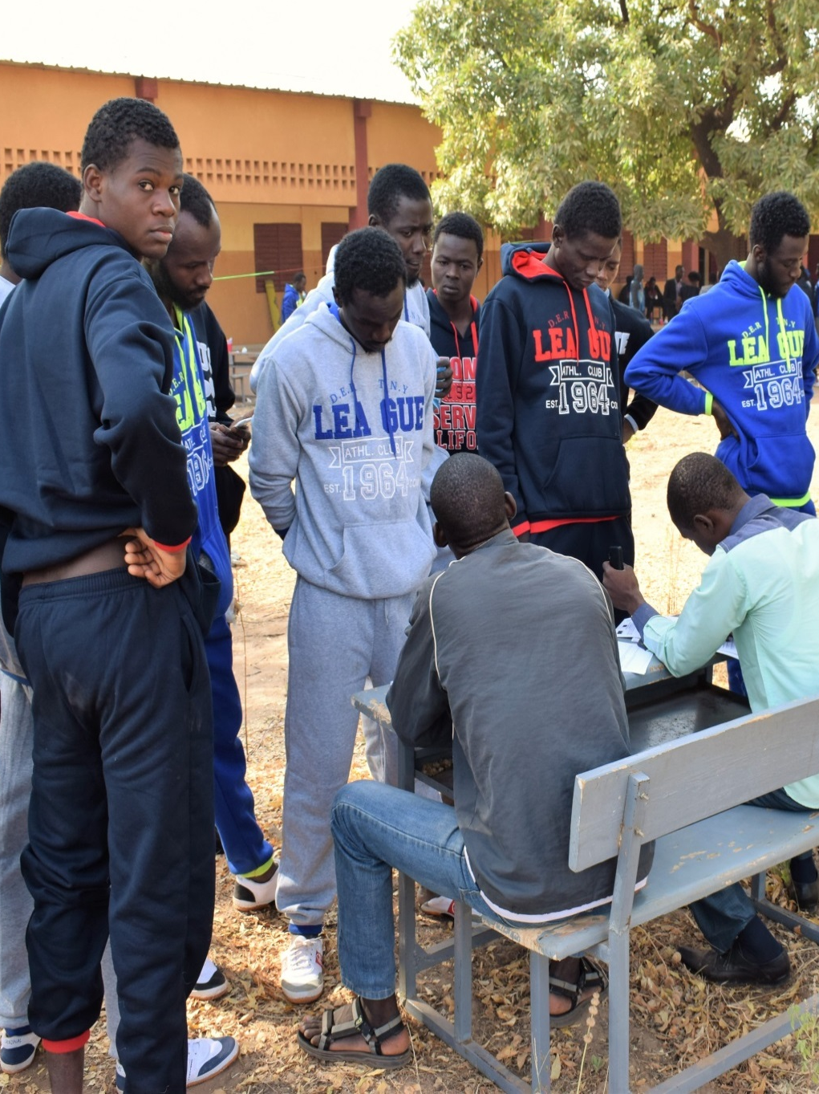
Our mandate
The EUTF Valetta constitutive Act stated a focus on activities that contribute to :
Establishing economic programmes that create employment opportunities, especially for young people and women in local communities, with a focus on vocational training and creation of micro and small enterprises
A special focus is given to involving the diaspora to this endeavour
Notes:
Economic opportunities –
M€ committed
2018 Outputs
(44.600) - 200 jobs created in 2017
1 186 jobs maintained
(2133) - 86 MSMEs supported in 2017
(48 000) 720 youth trained in 2017
Job creation:
Double approche:
Dans les pays d'origine de la migration
top priorities of the EUTF;
Stimuler l'entrepreunariat au travers d'un soutien au SMEs
Former les plus vulnérables, formal and unformal TVET
Favoriser l'auto-emploi
Soutenir la création d'emplois, y compris de court terme au travers de l'approche HIMO
Favoriser l'accès au financement
Dans les pays de transit, offrir des alternatives à l'économie construite autour de la migration irrégulière. Projets de réintégration, et de résinsertion des anciens passeurs.
Complété par des actions nationales et régionales, y compris le PEI (EIP)

Slide 3
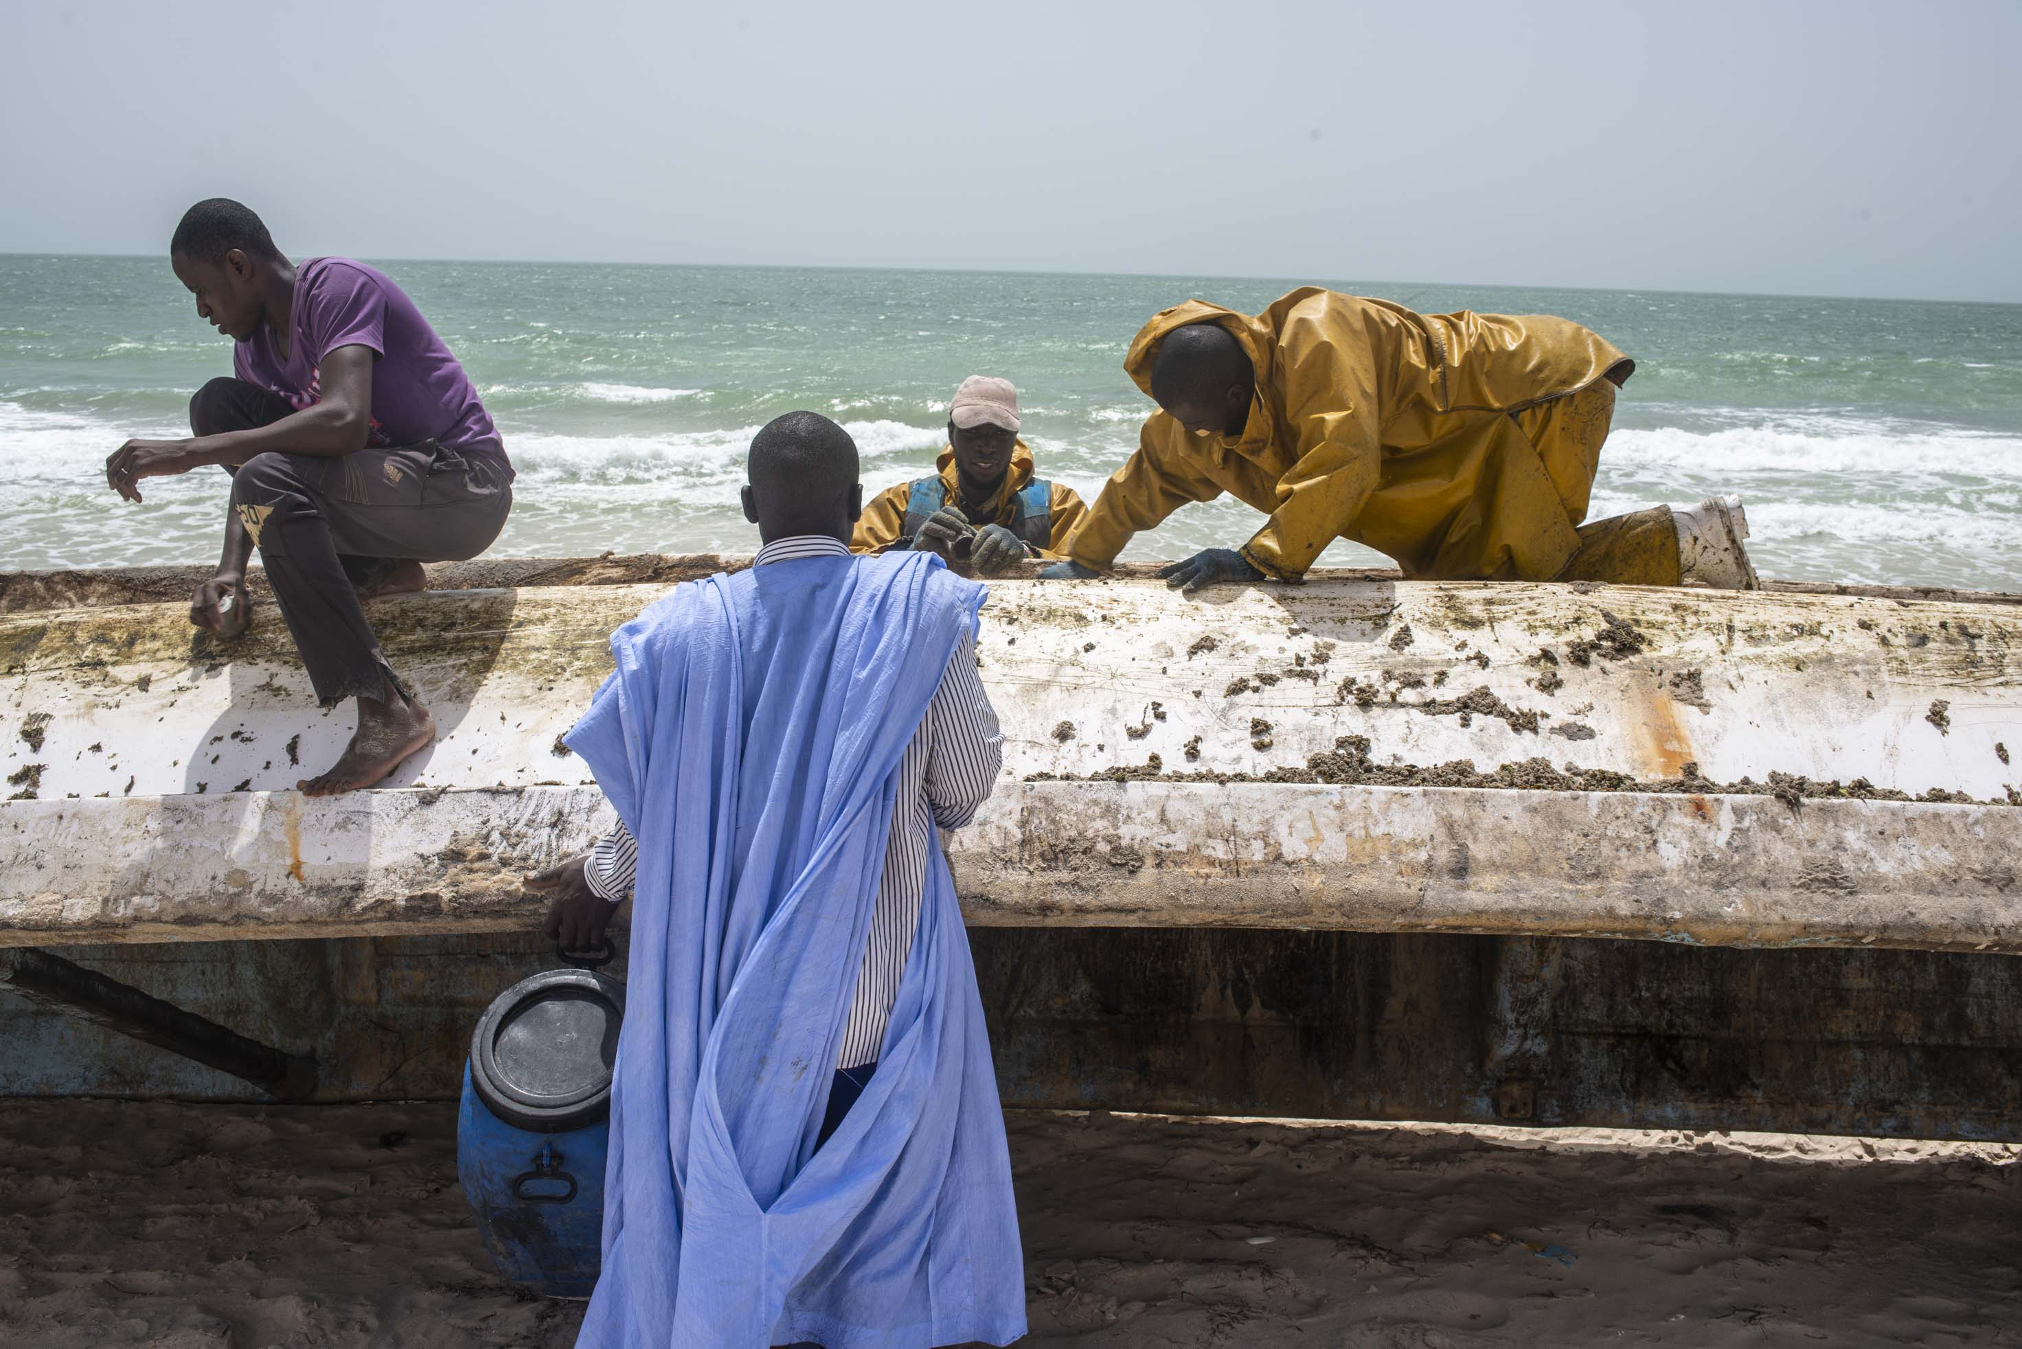
OUR two-fold APPROACH under EUTF Priority 1
Support the (Labor) – SUPPLY increase youth employability /skills /eco-social empowerment
Support the (Labor) - DEMAND: SMEs development, market access, financial market , facilitate investments, VC and sustainable rural growth, creating an enabling environment in regions of Origin/Return
+ Enabling business environment to attract FDI
Fully integrating : secondary education, dual TVET, HIMO, VC, rural economic development, entrepreneurship, diaspora involvement, inclusive finance, access to finance and BDS for SMEs….

Slide 4
OUR ENGAGEMENT /CONTRACTING STATUS
Update end 2018 –
22 decisions : 392.503 MEUR
28 contracts : 261.452 MEUR
A focus on diaspora in EUTF employment creation programmes in 2018/2019 :
Senegal : PASPED – PAISD (2 projects budget: 24,3 MEUR)
The Gambia: Make it in the Gambia – (1 project - budget : 23 /1MEUR)
Mali: PAIDM (1 project - Budget 6/1 MEUR for IFAD (crowd funding)
Update pipeline 2019
Ghana: Green jobs in rural areas (pipeline next OPCOM) 20 MEUR
Notes:
Total decisions: 22 – amount: 392.503 MEUR
Total Contracts: 28 – amount : 261,452 MEUR (1 managed at HQ level: ITC-EFI)- soon 2 more

Slide 5
Added value of diaspora in EUTF projects
In difficult- fragile- economic environment where most 'doing business indicators ' are RED …Is there an advocacy role for diaspora ?
1. Lobby; advocating cutting red tape, creating a more business enabling environment?
2. Businessmen allowing 'informal' business to grow formal, create jobs and become more competitive with improved governance structure, local and regional market access, and employment?
3. Investment engaging into intermediation and dialogue with financial institutions both in Europe and Africa in support of SMEs growth?
4. Experts engaging on skills gap analysis through dialogues between TVET institutions, Private sector and KEY diaspora members.

Slide 6
EUTF- Sahel and Lake Chad Window
https://ec.europa.eu/trustfundforafrica/
Corinne.Salinas@ec.europa.eu

